Slide 1
Satisfiability Modulo Theories (SMT): ideas and applications Università Degli Studi Di Milano Scuola di Dottorato in Informatica, 2010
Leonardo de Moura
Microsoft Research

Slide 2
Software development crisis
Software malfunction is a common problem.
Software complexity is increasing.
We need new methods and tools.

Slide 3
Program correctness
I proved my program to be correct.
What does it mean?

Slide 4
Software models
We need models and tools to reason about them?
Does my model/software has property X?

Slide 5
Symbolic Reasoning
Verification/Analysis tools need some form of Symbolic Reasoning

Slide 6
Symbolic Reasoning
Logic is “The Calculus of Computer Science” (Z. Manna).
High computational complexity
Undecidable
(FOL + LA)
Semi-decidable
(First-order logic)
NEXPTime-complete
(EPR)
PSpace-complete
(QBF)
NP-complete
(Propositional logic)
P-time
(Equality)

Slide 7
Applications
Test case generation
Verifying Compilers
Predicate Abstraction
Invariant Generation
Type Checking
Model Based Testing

Slide 8






Some Applications @ Microsoft
HAVOC
Hyper-V
Terminator T-2
VCC
NModel
Vigilante
SpecExplorer
F7
SAGE

Slide 9
Test case generation
unsigned GCD(x, y) {
requires(y > 0);
while (true) {
unsigned m = x % y;
if (m == 0) return y;
x = y;
y = m;
}
}
(y₀ > 0) and
(m₀ = x₀ % y₀) and
not (m₀ = 0) and
(x₁ = y₀) and
(y₁ = m₀) and
(m₁ = x₁ % y₁) and
(m₁ = 0)
x₀ = 2
y₀ = 4
m₀ = 2
x₁ = 4
y₁ = 2
m₁ = 0
SSA
Solver
We want a trace where the loop is executed twice.

Slide 10
Type checking
Signature:
div : int, { x : int | x ≠ 0 } → int
Subtype
Call site:
if a ≤ 1 and a ≤ b then
return div(a, b)
Verification condition
a ≤ 1 and a ≤ b implies b ≠ 0

Slide 11
What is logic?
Logic is the art and science of effective reasoning.
How can we draw general and reliable conclusions from a collection of facts?
Formal logic: Precise, syntactic characterizations of well-formed expressions and valid deductions.
Formal logic makes it possible to calculate consequences at the symbolic level.
Computers can be used to automate such symbolic calculations.

Slide 12
What is logic?
Logic studies the relationship between language, meaning, and (proof) method.
A logic consists of a language in which (well-formed) sentences are expressed.
A semantic that distinguishes the valid sentences from the refutable ones.
A proof system for constructing arguments justifying valid sentences.
Examples of logics include propositional logic, equational logic, first-order logic, higher-order logic, and modal logics.

Slide 13
What is logical language?
A language consists of logical symbols whose interpretations are fixed, and non-logical ones whose interpretations vary.
These symbols are combined together to form well-formed formulas.
In propositional logic PL, the connectives ∧, ∨, and ¬ have a fixed interpretation, whereas the constants p, q, r may be interpreted at will.

Slide 14
Propositional Logic
Formulas: ϕ := p | ϕ₁ ∨ϕ₂ | ϕ₁ ∧ϕ₂ | ¬ϕ₁ | ϕ₁ ⇒ ϕ₂
Examples:
p ∨ q ⇒ q ∨ p
p ∧ ¬q ∧ (¬p ∨ q)
We say p and q are propositional variables.
Exercise: Using a programming language, define a representation for formulas and a checker for well-formed formulas.

Slide 15
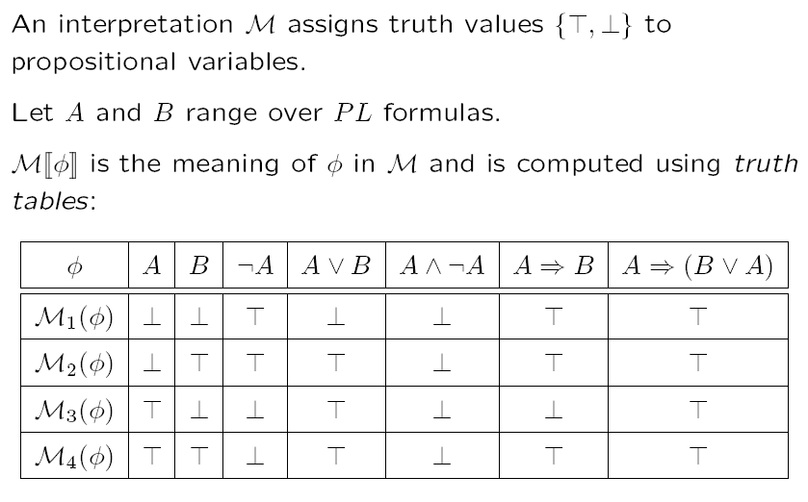
Interpretation

Slide 16
Satisfiability & Validity
A formula is satisfiable if it has an interpretation that makes it logically true.
In this case, we say the interpretation is a model.
A formula is unsatisfiable if it does not have any model.
A formula is valid if it is logically true in any interpretation.
A propositional formula is valid if and only if its negation is unsatisfiable.

Slide 17
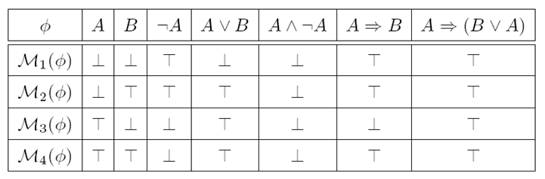
Satisfiability & Validity: examples
p ∨ q ⇒ q ∨ p
p ∨ q ⇒ q
p ∧ ¬q ∧ (¬p ∨ q)

Slide 18
Satisfiability & Validity: examples
p ∨ q ⇒ q ∨ p VALID
p ∨ q ⇒ q SATISFIABLE
p ∧ ¬q ∧ (¬p ∨ q) UNSATISFIABLE

Slide 19
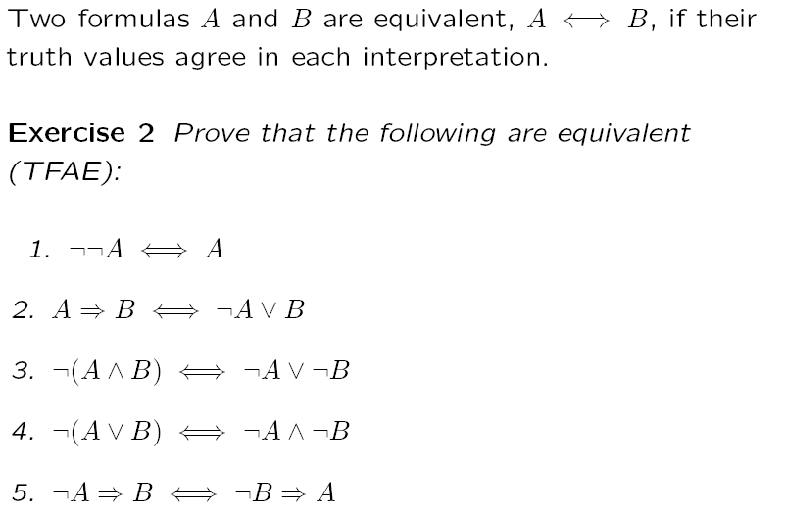
Equivalence

Slide 20
Equisatisfiable
We say formulas A and B are equisatisfiable if and only if A is satisfiable if and only if B is.
During this course, we will describe transformations that preserve equivalence and equisatisfiability.

Slide 21
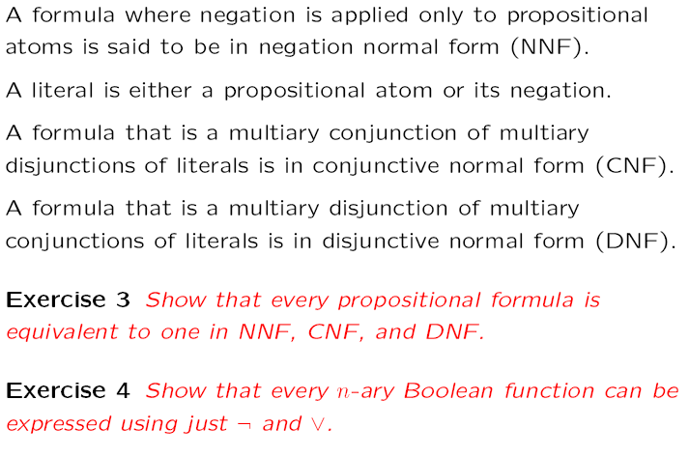
Normal Forms

Slide 22
Normal Forms
NNF?
(p ∨ ¬q) ∧ (q ∨ ¬(r ∧ ¬p))

Slide 23
Normal Forms
NNF? NO
(p ∨ ¬q) ∧ (q ∨ ¬(r ∧ ¬p))

Slide 24
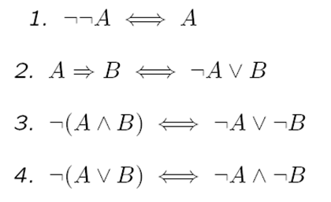
Normal Forms
NNF? NO
(p ∨ ¬q) ∧ (q ∨ ¬(r ∧ ¬p))

Slide 25
Normal Forms
NNF? NO
(p ∨ ¬q) ∧ (q ∨ ¬(r ∧ ¬p))
⇔
(p ∨ ¬q) ∧ (q ∨ (¬r ∨ ¬¬p))

Slide 26
Normal Forms
NNF? NO
(p ∨ ¬q) ∧ (q ∨ ¬(r ∧ ¬p))
⇔
(p ∨ ¬q) ∧ (q ∨ (¬r ∨ ¬¬p))
⇔
(p ∨ ¬q) ∧ (q ∨ (¬r ∨ p))

Slide 27
Normal Forms
CNF?
((p ∧ s) ∨ (¬q ∧ r)) ∧ (q ∨ ¬p ∨ s) ∧ (¬r ∨ s)

Slide 28
Normal Forms
CNF? NO
((p ∧ s) ∨ (¬q ∧ r)) ∧ (q ∨ ¬p ∨ s) ∧ (¬r ∨ s)

Slide 29
Normal Forms
CNF? NO
((p ∧ s) ∨ (¬q ∧ r)) ∧ (q ∨ ¬p ∨ s) ∧ (¬r ∨ s)
Distributivity
1. A∨(B∧C) ⇔ (A∨B)∧(A∨C)
2. A∧(B∨C) ⇔ (A∧B)∨(A∧C)

Slide 30
Normal Forms
CNF? NO
((p ∧ s) ∨ (¬q ∧ r)) ∧ (q ∨ ¬p ∨ s) ∧ (¬r ∨ s)
⇔
((p ∧ s) ∨ ¬q)) ∧ ((p ∧ s) ∨ r)) ∧ (q ∨ ¬p ∨ s) ∧ (¬r ∨ s)
Distributivity
1. A∨(B∧C) ⇔ (A∨B)∧(A∨C)
2. A∧(B∨C) ⇔ (A∧B)∨(A∧C)

Slide 31
Normal Forms
CNF? NO
((p ∧ s) ∨ (¬q ∧ r)) ∧ (q ∨ ¬p ∨ s) ∧ (¬r ∨ s)
⇔
((p ∧ s) ∨ ¬q)) ∧ ((p ∧ s) ∨ r)) ∧ (q ∨ ¬p ∨ s) ∧ (¬r ∨ s)
⇔
(p ∨ ¬q) ∧ (s ∨ ¬q) ∧ ((p ∧ s) ∨ r)) ∧ (q ∨ ¬p ∨ s) ∧ (¬r ∨ s)
Distributivity
1. A∨(B∧C) ⇔ (A∨B)∧(A∨C)
2. A∧(B∨C) ⇔ (A∧B)∨(A∧C)

Slide 32
Normal Forms
CNF? NO
((p ∧ s) ∨ (¬q ∧ r)) ∧ (q ∨ ¬p ∨ s) ∧ (¬r ∨ s)
⇔
((p ∧ s) ∨ ¬q)) ∧ ((p ∧ s) ∨ r)) ∧ (q ∨ ¬p ∨ s) ∧ (¬r ∨ s)
⇔
(p ∨ ¬q) ∧ (s ∨ ¬q) ∧ ((p ∧ s) ∨ r)) ∧ (q ∨ ¬p ∨ s) ∧ (¬r ∨ s)
⇔
(p ∨ ¬q) ∧ (s ∨ ¬q) ∧ (p ∨ r) ∧ (s ∨ r) ∧ (q ∨ ¬p ∨ s) ∧ (¬r ∨ s)

Slide 33
Normal Forms
DNF?
p ∧ (¬p ∨ q) ∧ (¬q ∨ r)

Slide 34
Normal Forms
DNF? NO, actually this formula is in CNF
p ∧ (¬p ∨ q) ∧ (¬q ∨ r)

Slide 35
Normal Forms
DNF? NO, actually this formula is in CNF
p ∧ (¬p ∨ q) ∧ (¬q ∨ r)
Distributivity
1. A∨(B∧C) ⇔ (A∨B)∧(A∨C)
2. A∧(B∨C) ⇔ (A∧B)∨(A∧C)

Slide 36
Normal Forms
DNF? NO, actually this formula is in CNF
p ∧ (¬p ∨ q) ∧ (¬q ∨ r)
⇔
((p ∧ ¬p) ∨ (p ∨ q)) ∧ (¬q ∨ r)
Distributivity
1. A∨(B∧C) ⇔ (A∨B)∧(A∨C)
2. A∧(B∨C) ⇔ (A∧B)∨(A∧C)

Slide 37
Normal Forms
DNF? NO, actually this formula is in CNF
p ∧ (¬p ∨ q) ∧ (¬q ∨ r)
⇔
((p ∧ ¬p) ∨ (p ∨ q)) ∧ (¬q ∨ r)
⇔
(p ∨ q) ∧ (¬q ∨ r)
Distributivity
1. A∨(B∧C) ⇔ (A∨B)∧(A∨C)
2. A∧(B∨C) ⇔ (A∧B)∨(A∧C)
Other Rules
A∧¬A ⇔ ⊥
A∨⊥ ⇔ A

Slide 38
Normal Forms
DNF? NO, actually this formula is in CNF
p ∧ (¬p ∨ q) ∧ (¬q ∨ r)
⇔
((p ∧ ¬p) ∨ (p ∨ q)) ∧ (¬q ∨ r)
⇔
(p ∨ q) ∧ (¬q ∨ r)
⇔
((p ∨ q) ∧ ¬q) ∨ ((p ∨ q) ∧ r)
Distributivity
1. A∨(B∧C) ⇔ (A∨B)∧(A∨C)
2. A∧(B∨C) ⇔ (A∧B)∨(A∧C)
Other Rules
A∧¬A ⇔ ⊥
A∨⊥ ⇔ A

Slide 39
Normal Forms
DNF? NO, actually this formula is in CNF
p ∧ (¬p ∨ q) ∧ (¬q ∨ r)
⇔
((p ∧ ¬p) ∨ (p ∨ q)) ∧ (¬q ∨ r)
⇔
(p ∨ q) ∧ (¬q ∨ r)
⇔
((p ∨ q) ∧ ¬q) ∨ ((p ∨ q) ∧ r)
⇔
(p ∧ ¬q) ∨ (q ∧ ¬q) ∨ ((p ∨ q) ∧ r)
⇔
(p ∧ ¬q) ∨ (p ∧ r) ∨ (q ∧ r)

Slide 40
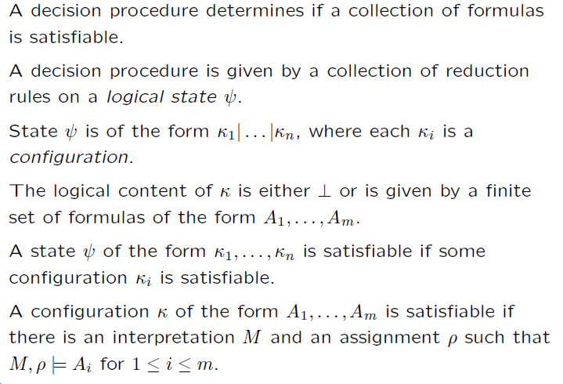
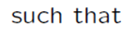
Refutation Decision Procedures

Slide 41
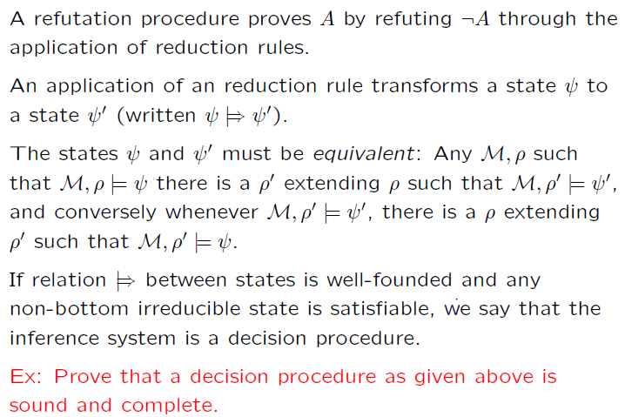
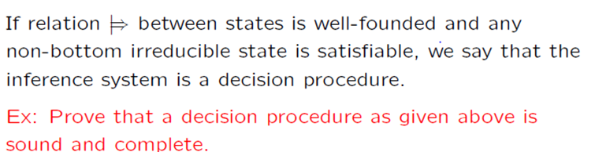
Inference Systems for Decision Procedures
Rules preserve satisfiability.

Slide 42
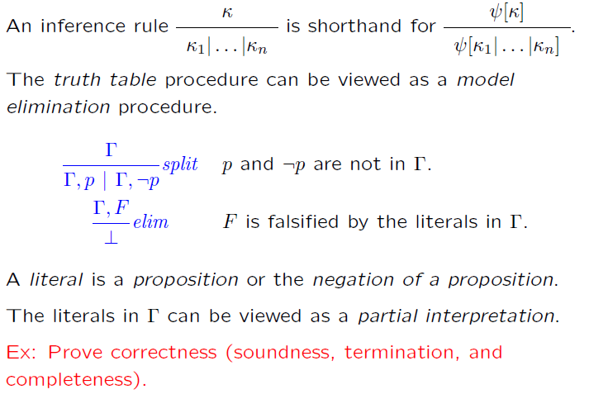
Truth Table

Slide 43
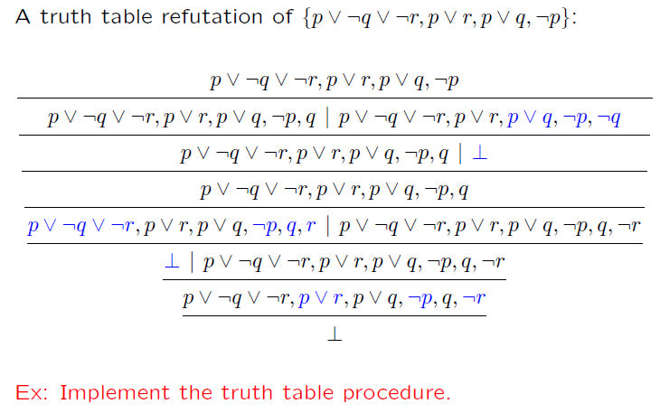
Truth Table (example)

Slide 44
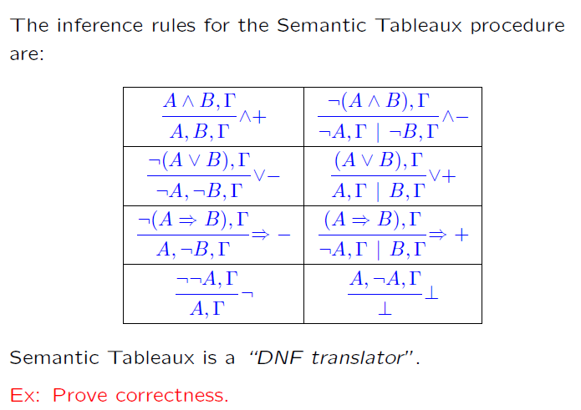
Semantic Tableaux

Slide 45
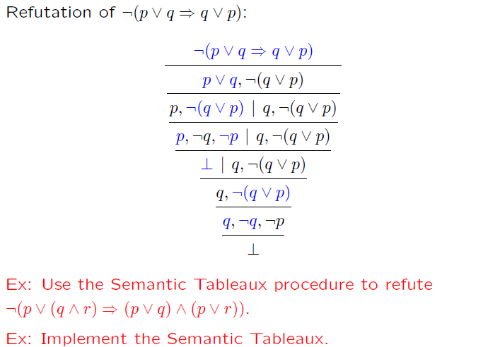
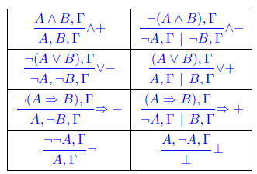
Semantic Tableaux (example)

Slide 46
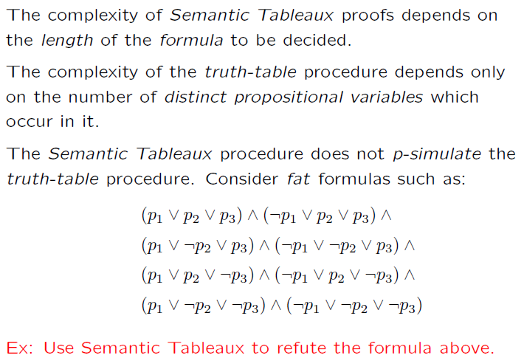
Semantic Tableaux (cont.)

Slide 47
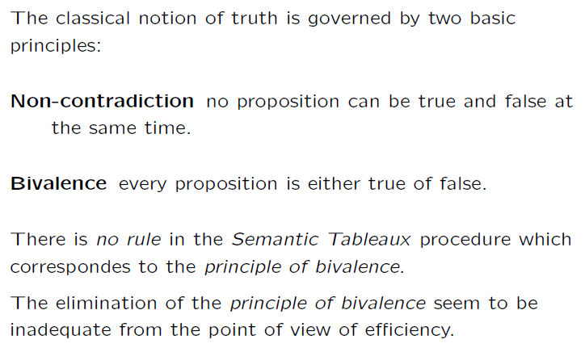
Semantic Tableaux (cont.)

Slide 48
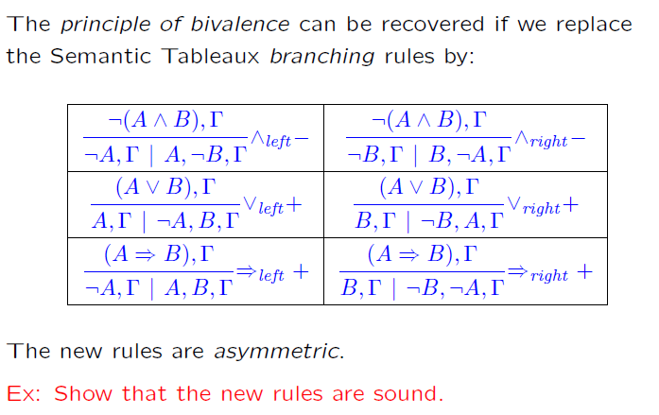
Semantic Tableaux + Bivalence

Slide 49
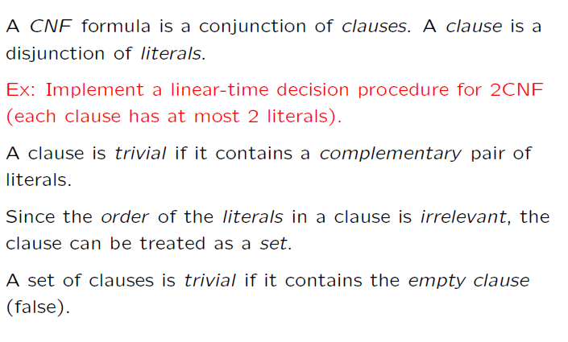
CNF (again)

Slide 50
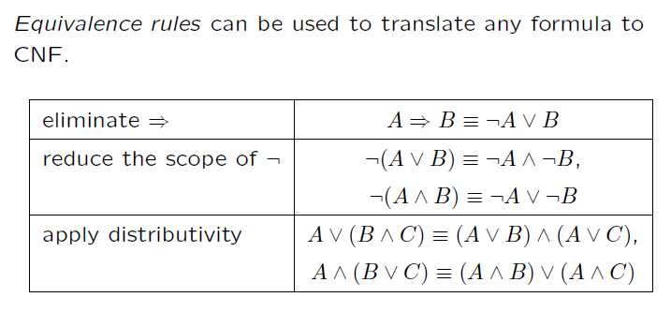
CNF (again)

Slide 51
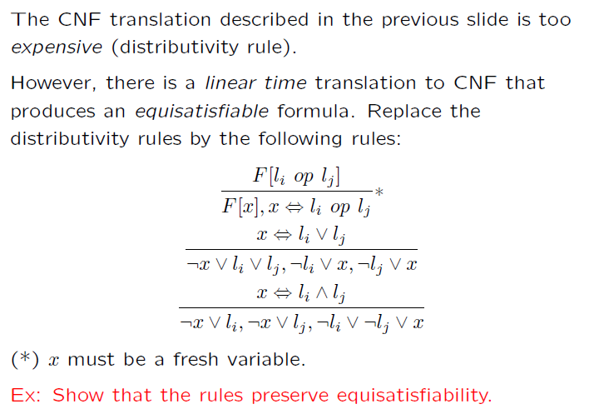
CNF (again)

Slide 52
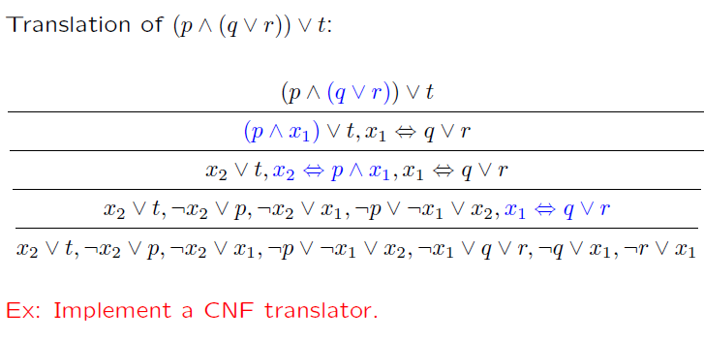
CNF translation (example)

Slide 53
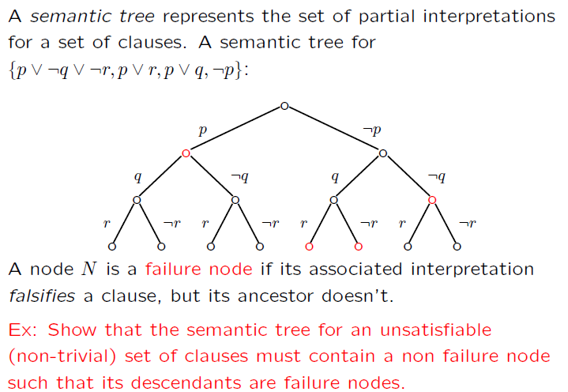
Semantic Trees

Slide 54
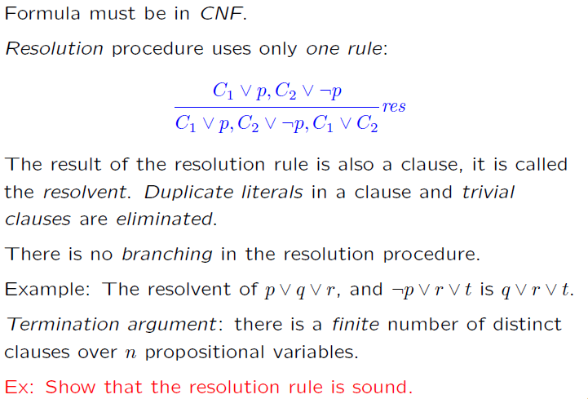
Resolution

Slide 55
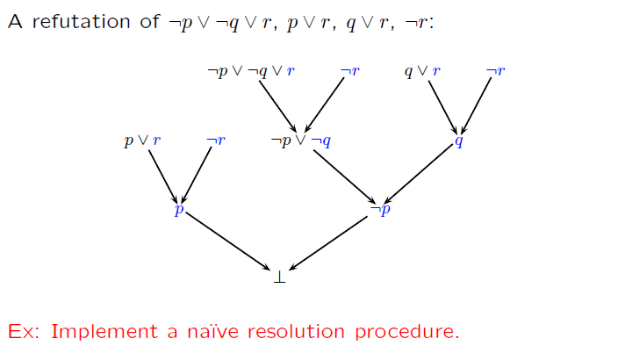
Resolution (example)

Slide 56
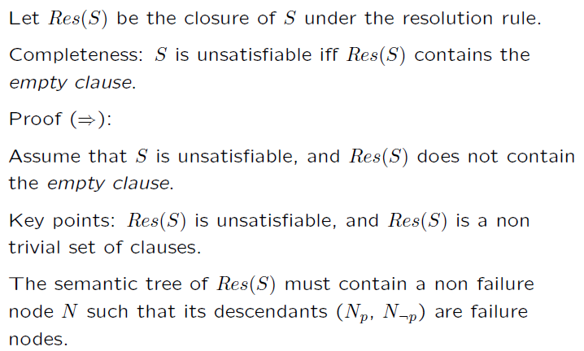
Completeness of Resolution

Slide 57
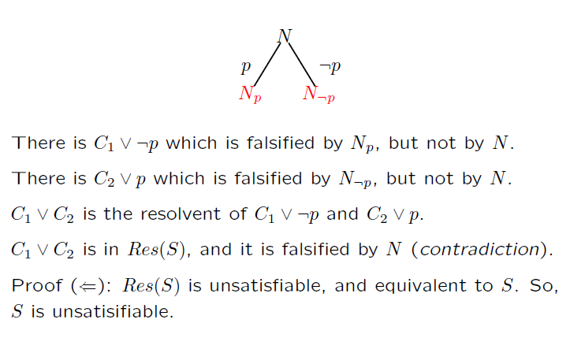
Completeness of Resolution

Slide 58
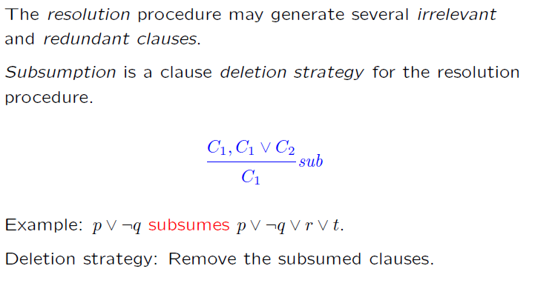
Subsumption

Slide 59
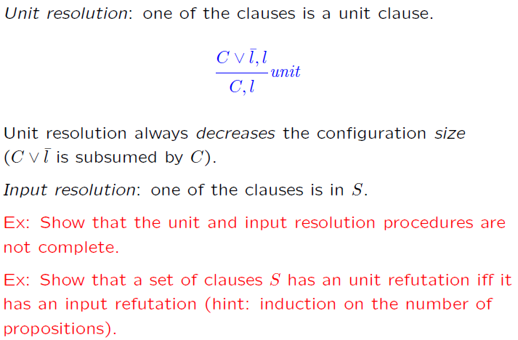
Unit & Input Resolution

Slide 60
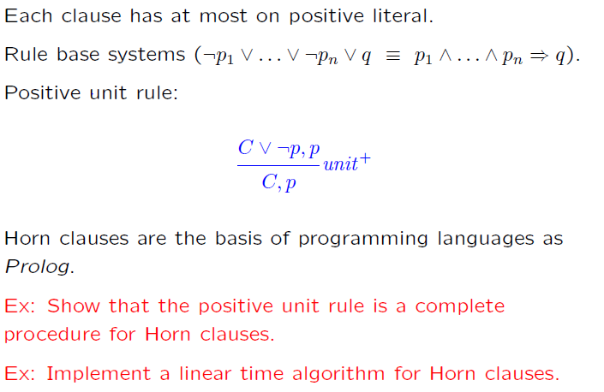
Horn Clauses

Slide 61
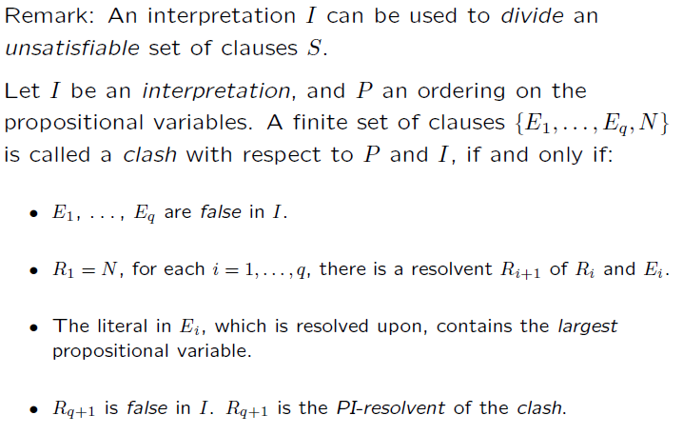
Semantic Resolution

Slide 62
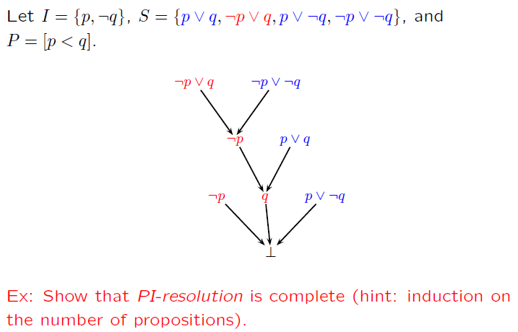
Semantic Resolution (example)

Slide 63
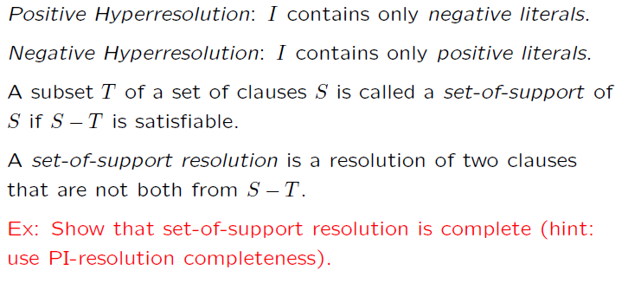
Semantic Resolution (special cases)

Slide 64
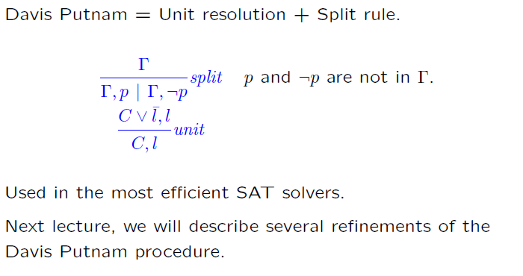
DPLL
DPLL

Slide 65
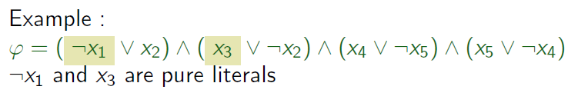
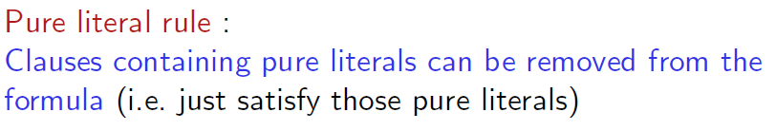
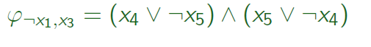
Pure Literals
A literal is pure if only occurs positively or negatively.

Slide 66
Pure Literals
A literal is pure if only occurs positively or negatively.

Slide 67
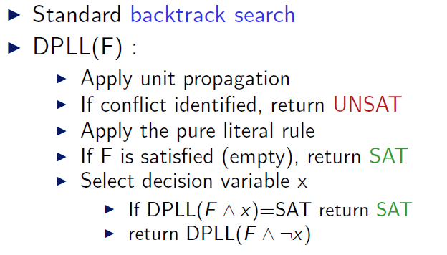
DPLL (as a procedure)

Slide 68
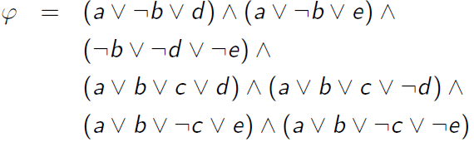
DPLL (example)

Slide 69
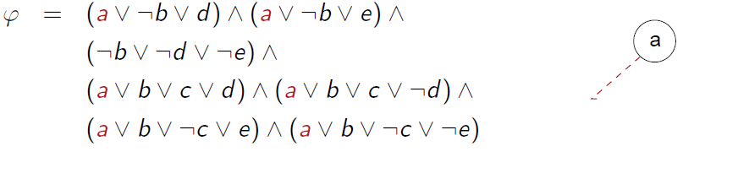
DPLL (example)

Slide 70
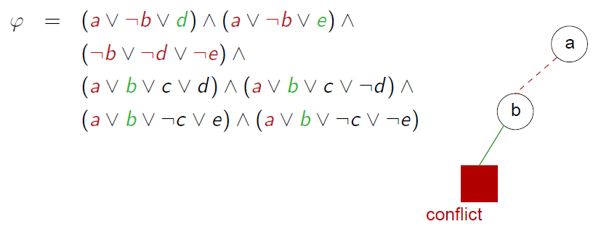
DPLL (example)

Slide 71
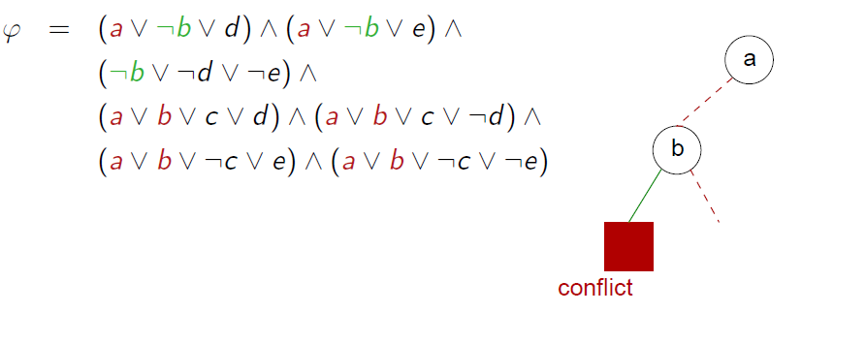
DPLL (example)

Slide 72
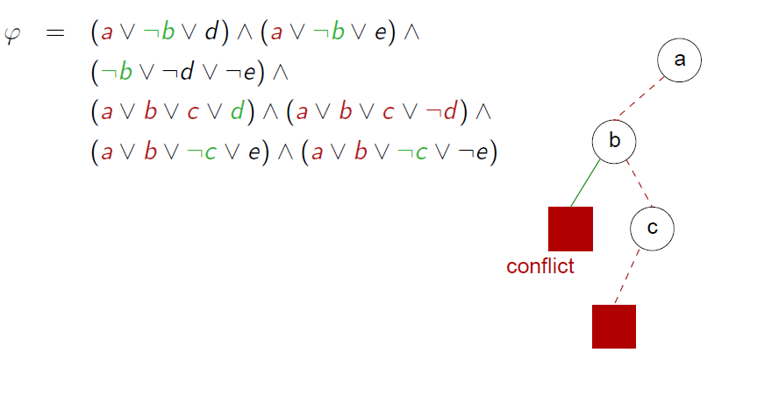
DPLL (example)

Slide 73
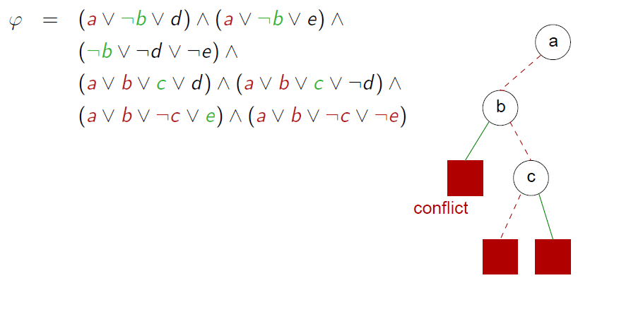
DPLL (example)

Slide 74
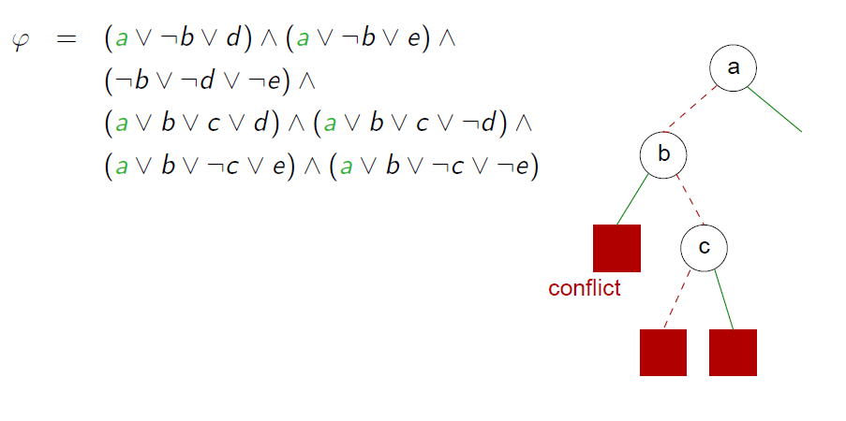
DPLL (example)

Slide 75
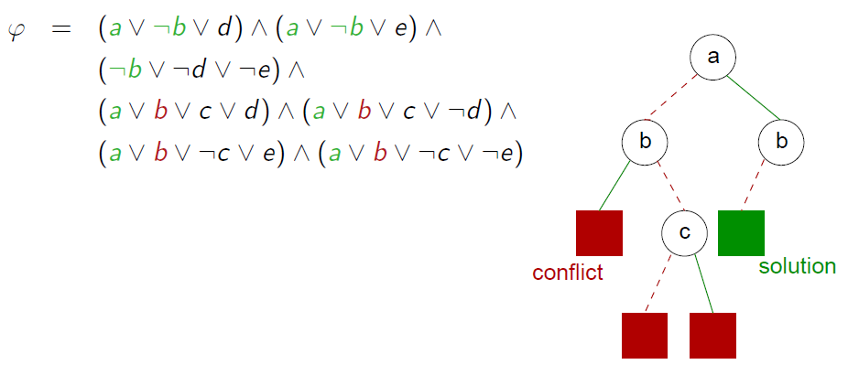
DPLL (example)

Slide 76
Some Applications

Slide 77
Bit-vector / Machine arithmetic
Let x, y and z be 8-bit (unsigned) integers.
Is x > 0 ∧ y > 0 ∧ z = x + y ⇒ z > 0 valid?
Is x > 0 ∧ y > 0 ∧ z = x + y ∧ ¬(z > 0) satisfiable?

Slide 78
Bit-vector / Machine arithmetic
We can encode bit-vector satisfiability problems in propositional logic.
Idea 1:
Use n propositional variables to encode n-bit integers.
x → (x₁, …, x_{n})
Idea 2:
Encode arithmetic operations using hardware circuits.

Slide 79
Encoding equality
p ⇔ q is equivalent to (¬p ∨ q) ∧ (¬q ∨ p)
The bit-vector equation x = y is encoded as:
(x₁ ⇔ y₁) ∧ … ∧ (x_{n} ⇔ y_{n})

Slide 80
Encoding addition
We use (r₁, …, r_{n}) to store the result of x + y
p xor q is defined as ¬(p ⇔ q)
xor is the 1-bit adder
carry
p | q | p xor q | p ∧ q
0 | 0 | 0 | 0
1 | 0 | 1 | 0
0 | 1 | 1 | 0
1 | 1 | 0 | 1

Slide 81
Encoding 1-bit full adder
1-bit full adder
Three inputs: x, y, c_{in}
Two outputs: r, c_{out}
x | y | c_{in} | r = x xor y xor c_{in} | c_{out} = (x ∧ y)∨(x ∧ c_{in})∨(y ∧ c_{in})
0 | 0 | 0 | 0 | 0
1 | 0 | 0 | 1 | 0
0 | 1 | 0 | 1 | 0
1 | 1 | 0 | 0 | 1
0 | 0 | 1 | 1 | 0
1 | 0 | 1 | 0 | 1
0 | 1 | 1 | 0 | 1
1 | 1 | 1 | 1 | 1

Slide 82
Encoding n-bit adder
We use (r₁, …, r_{n}) to store the result of x + y,
and (c₁, …, c_{n})
r₁ ⇔ (x₁ xor y₁)
c₁ ⇔ (x₁ ∧ y₁)
r₂ ⇔ (x₂ xor y₂ xor c₁)
c₂ ⇔ (x₂ ∧ y₂) ∨ (x₂ ∧ c₁) ∨ (y₂ ∧ c₁)
…
r_{n} ⇔ (x_{n} xor y_{n} xor c_{n-1})
c_{n} ⇔ (x_{n} ∧ y_{n}) ∨ (x_{n} ∧ c_{n-1}) ∨ (y_{n} ∧ c_{n-1})

Slide 83
Exercises
Encode x * y
Encode x > y (signed and unsigned versions)

Slide 84
Test case generation (again)
unsigned GCD(x, y) {
requires(y > 0);
while (true) {
unsigned m = x % y;
if (m == 0) return y;
x = y;
y = m;
}
}
(y₀ > 0) and
(m₀ = x₀ % y₀) and
not (m₀ = 0) and
(x₁ = y₀) and
(y₁ = m₀) and
(m₁ = x₁ % y₁) and
(m₁ = 0)
x₀ = 2
y₀ = 4
m₀ = 2
x₁ = 4
y₁ = 2
m₁ = 0
SSA
Solver
We want a trace where the loop is executed twice.

Slide 85
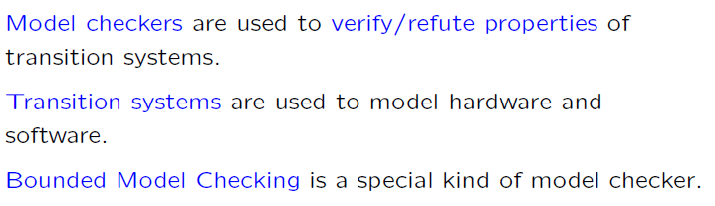
Bounded Model Checkers

Slide 86
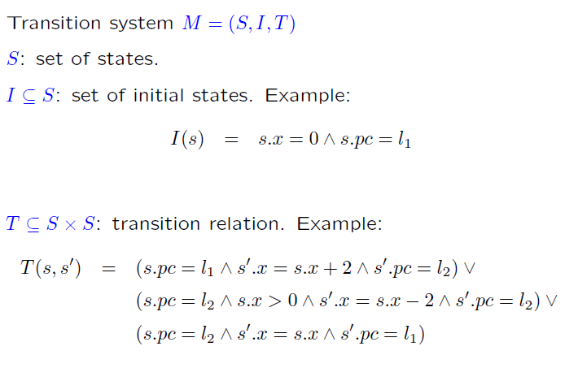
Transition Systems

Slide 87
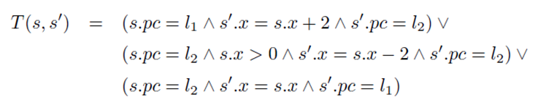
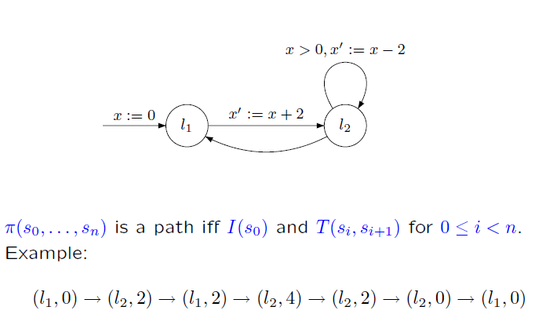
Transition Systems (cont.)

Slide 88
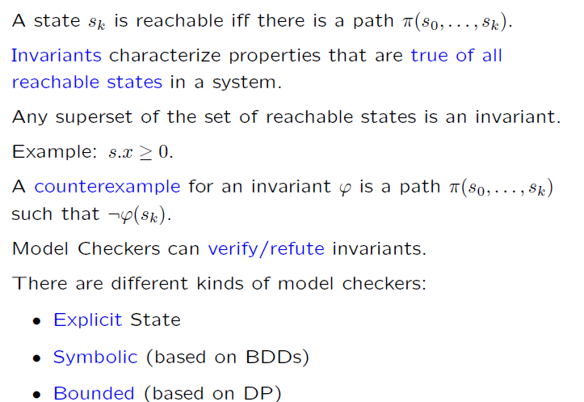
Invariants

Slide 89

Bounded Model Checking: Invariants

Slide 90
Bounded Model Checking: Invariants

Slide 91

Bounded Model Checking (cont.)

Slide 92

Recurrence diameter

Slide 93

Verifying Invariants

Slide 94

Verifying Invariants: k-induction

Slide 95

Verifying Invariants: k-induction (cont.)

Slide 96

Verifying Invariants: k-induction (cont.)

Slide 97

Experimental Exercises

Slide 98

Available SAT Solvers

Slide 99
Available Examples
Satisfiability library: http://www.satlib.org
The SAT competion: http://www.satcompetition.org
Search the WEB: “SAT benchmarks”

Slide 100

Using SAT solvers

Slide 101
Satisfiability Modulo Theories (SMT)
Is formula F satisfiable modulo theory T ?
SMT solvers have specialized algorithms for T

Slide 102
Satisfiability Modulo Theories (SMT)
b + 2 = c and f(read(write(a,b,3), c-2)) ≠ f(c-b+1)

Slide 103
Satisfiability Modulo Theories (SMT)
b + 2 = c and f(read(write(a,b,3), c-2)) ≠ f(c-b+1)
Arithmetic

Slide 104
Satisfiability Modulo Theories (SMT)
b + 2 = c and f(read(write(a,b,3), c-2)) ≠ f(c-b+1)
Array Theory
Arithmetic

Slide 105
Satisfiability Modulo Theories (SMT)
b + 2 = c and f(read(write(a,b,3), c-2)) ≠ f(c-b+1)
Uninterpreted Functions
Array Theory
Arithmetic

Slide 106
Satisfiability Modulo Theories (SMT)
b + 2 = c and f(read(write(a,b,3), c-2)) ≠ f(c-b+1)
Substituting c by b+2

Slide 107
Satisfiability Modulo Theories (SMT)
b + 2 = c and f(read(write(a,b,3), b+2-2)) ≠ f(b+2-b+1)
Simplifying

Slide 108
Satisfiability Modulo Theories (SMT)
b + 2 = c and f(read(write(a,b,3), b)) ≠ f(3)

Slide 109
Satisfiability Modulo Theories (SMT)
b + 2 = c and f(read(write(a,b,3), b)) ≠ f(3)
Applying array theory axiom
forall a,i,v: read(write(a,i,v), i) = v

Slide 110
Satisfiability Modulo Theories (SMT)
b + 2 = c and f(3) ≠ f(3)
Inconsistent

Slide 111
SMT-Lib
Repository of Benchmarks
http://www.smtlib.org
Benchmarks are divided in “logics”:
QF_UF: unquantified formulas built over a signature of uninterpreted sort, function and predicate symbols.
QF_UFLIA: unquantified linear integer arithmetic with uninterpreted sort, function, and predicate symbols.
AUFLIA: closed linear formulas over the theory of integer arrays with free sort, function and predicate symbols.

Slide 112
Ground formulas
For most SMT solvers: F is a set of ground formulas
Many Applications
Bounded Model Checking
Test-Case Generation

Slide 113
Little Engines of Proof
An SMT Solver is a collection of
Little Engines of Proof

Slide 114
Little Engines of Proof
An SMT Solver is a collection of
Little Engines of Proof
Examples:
SAT Solver (Daniel’s lectures)
Equality solver

Slide 115
Deciding Equality
a = b, b = c, d = e, b = s, d = t, a≠ e, a≠ s
a
b
c
d
e
s
t

Slide 116
Deciding Equality
a = b, b = c, d = e, b = s, d = t, a≠ e, a≠ s
a
b
c
d
e
s
t

Slide 117
Deciding Equality
a = b, b = c, d = e, b = s, d = t, a≠ e, a≠ s
a,b
c
d
e
s
t

Slide 118
Deciding Equality
a = b, b = c, d = e, b = s, d = t, a≠ e, a≠ s
a,b
c
d
e
s
t

Slide 119
Deciding Equality
a = b, b = c, d = e, b = s, d = t, a≠ e, a≠ s
a,b,c
d
e
s
t

Slide 120
Deciding Equality
a = b, b = c, d = e, b = s, d = t, a≠ e, a≠ s
a,b,c
d
e
s
t

Slide 121
Deciding Equality
a = b, b = c, d = e, b = s, d = t, a≠ e, a≠ s
a,b,c
d,e
s
t

Slide 122
Deciding Equality
a = b, b = c, d = e, b = s, d = t, a≠ e, a≠ s
a,b,c
d,e
s
t

Slide 123
Deciding Equality
a = b, b = c, d = e, b = s, d = t, a≠ e, a≠ s
a,b,c,s
d,e
t

Slide 124
Deciding Equality
a = b, b = c, d = e, b = s, d = t, a≠ e, a≠ s
a,b,c,s
d,e
t

Slide 125
Deciding Equality
a = b, b = c, d = e, b = s, d = t, a≠ e, a≠ s
a,b,c,s
d,e,t

Slide 126
Deciding Equality
a = b, b = c, d = e, b = s, d = t, a≠ e, a≠ s
a,b,c,s
d,e,t

Slide 127
Deciding Equality
a = b, b = c, d = e, b = s, d = t, a≠ e, a≠ s
a,b,c,s
d,e,t
Unsatisfiable

Slide 128
Deciding Equality
a = b, b = c, d = e, b = s, d = t, a≠ e
a,b,c,s
d,e,t
Model construction

Slide 129
Deciding Equality
a = b, b = c, d = e, b = s, d = t, a≠ e
a,b,c,s
♦₁
♦₂
d,e,t
Model construction
|M| = {♦₁ ,♦₂} (universe, aka domain)

Slide 130
Deciding Equality
a = b, b = c, d = e, b = s, d = t, a≠ e
a,b,c,s
♦₁
♦₂
d,e,t
Model construction
|M| = {♦₁ ,♦₂} (universe, aka domain)
M(a) = ♦₁ (assignment)

Slide 131
Deciding Equality
a = b, b = c, d = e, b = s, d = t, a≠ e
a,b,c,s
♦₁
♦₂
d,e,t
Alternative notation:
a^{M} = ♦₁
Model construction
|M| = {♦₁ ,♦₂} (universe, aka domain)
M(a) = ♦₁ (assignment)

Slide 132
Deciding Equality
a = b, b = c, d = e, b = s, d = t, a≠ e
a,b,c,s
♦₁
♦₂
d,e,t
Model construction
|M| = {♦₁ ,♦₂} (universe, aka domain)
M(a) = M(b) = M(c) = M(s) = ♦₁
M(d) = M(e) = M(t) = ♦₂

Slide 133
Deciding Equality
a = b, b = c, d = e, b = s, d = t, a≠ e
a,b,c,s
♦₁
♦₂
d,e,t
Model construction
|M| = {♦₁ ,♦₂} (universe, aka domain)
M(a) = M(b) = M(c) = M(s) = ♦₁
M(d) = M(e) = M(t) = ♦₂

Slide 134
Deciding Equality: Termination, Soundness, Completeness
Termination: easy
Soundness
Invariant: all constants in a “ball” are known to be equal.
The “ball” merge operation is justified by:
Transitivity and Symmetry rules.
Completeness
We can build a model if an inconsistency was not detected.
Proof template (by contradiction):
Build a candidate model.
Assume a literal was not satisfied.
Find contradiction.

Slide 135
Deciding Equality: Termination, Soundness, Completeness
Completeness
We can build a model if an inconsistency was not detected.
Instantiating the template for our procedure:
Assume some literal c = d is not satisfied by our model.
That is, M(c) ≠ M(d).
This is impossible, c and d must be in the same “ball”.
c,d,…
♦_{i}
M(c) = M(d) = ♦_{i}

Slide 136
Deciding Equality: Termination, Soundness, Completeness
Completeness
We can build a model if an inconsistency was not detected.
Instantiating the template for our procedure:
Assume some literal c ≠ d is not satisfied by our model.
That is, M(c) = M(d).
Key property: we only check the disequalities after we processed all equalities.
This is impossible, c and d must be in the different “balls”
c,…
d,…
♦_{i}
♦_{j}
M(c) = ♦_{i}
M(d) = ♦_{j}

Slide 137
Deciding Equality + (uninterpreted) Functions
a = b, b = c, d = e, b = s, d = t, f(a, g(d)) ≠ f(b, g(e))
Congruence Rule:
x₁ = y₁, …, x_{n} = y_{n} implies f(x₁, …, x_{n}) = f(y₁, …, y_{n})

Slide 138
Deciding Equality + (uninterpreted) Functions
a = b, b = c, d = e, b = s, d = t, f(a, g(d)) ≠ f(b, g(e))
First Step: “Naming” subterms
Congruence Rule:
x₁ = y₁, …, x_{n} = y_{n} implies f(x₁, …, x_{n}) = f(y₁, …, y_{n})

Slide 139
Deciding Equality + (uninterpreted) Functions
a = b, b = c, d = e, b = s, d = t, f(a, v₁) ≠ f(b, g(e))
v₁ ≡ g(d)
First Step: “Naming” subterms
Congruence Rule:
x₁ = y₁, …, x_{n} = y_{n} implies f(x₁, …, x_{n}) = f(y₁, …, y_{n})

Slide 140
Deciding Equality + (uninterpreted) Functions
a = b, b = c, d = e, b = s, d = t, f(a, v₁) ≠ f(b, g(e))
v₁ ≡ g(d)
First Step: “Naming” subterms
Congruence Rule:
x₁ = y₁, …, x_{n} = y_{n} implies f(x₁, …, x_{n}) = f(y₁, …, y_{n})

Slide 141
Deciding Equality + (uninterpreted) Functions
a = b, b = c, d = e, b = s, d = t, f(a, v₁) ≠ f(b, v₂)
v₁ ≡ g(d), v₂ ≡ g(e)
First Step: “Naming” subterms
Congruence Rule:
x₁ = y₁, …, x_{n} = y_{n} implies f(x₁, …, x_{n}) = f(y₁, …, y_{n})

Slide 142
Deciding Equality + (uninterpreted) Functions
a = b, b = c, d = e, b = s, d = t, f(a, v₁) ≠ f(b, v₂)
v₁ ≡ g(d), v₂ ≡ g(e)
First Step: “Naming” subterms
Congruence Rule:
x₁ = y₁, …, x_{n} = y_{n} implies f(x₁, …, x_{n}) = f(y₁, …, y_{n})

Slide 143
Deciding Equality + (uninterpreted) Functions
a = b, b = c, d = e, b = s, d = t, v₃ ≠ f(b, v₂)
v₁ ≡ g(d), v₂ ≡ g(e), v₃ ≡ f(a, v₁)
First Step: “Naming” subterms
Congruence Rule:
x₁ = y₁, …, x_{n} = y_{n} implies f(x₁, …, x_{n}) = f(y₁, …, y_{n})

Slide 144
Deciding Equality + (uninterpreted) Functions
a = b, b = c, d = e, b = s, d = t, v₃ ≠ f(b, v₂)
v₁ ≡ g(d), v₂ ≡ g(e), v₃ ≡ f(a, v₁)
First Step: “Naming” subterms
Congruence Rule:
x₁ = y₁, …, x_{n} = y_{n} implies f(x₁, …, x_{n}) = f(y₁, …, y_{n})

Slide 145
Deciding Equality + (uninterpreted) Functions
a = b, b = c, d = e, b = s, d = t, v₃ ≠ v₄
v₁ ≡ g(d), v₂ ≡ g(e), v₃ ≡ f(a, v₁) , v₄ ≡ f(b, v₂)
First Step: “Naming” subterms
Congruence Rule:
x₁ = y₁, …, x_{n} = y_{n} implies f(x₁, …, x_{n}) = f(y₁, …, y_{n})

Slide 146
Deciding Equality + (uninterpreted) Functions
a = b, b = c, d = e, b = s, d = t, v₃ ≠ v₄
v₁ ≡ g(d), v₂ ≡ g(e), v₃ ≡ f(a, v₁) , v₄ ≡ f(b, v₂)
a,b,c,s
d,e,t
v₁
v₂
v₃
v₄
Congruence Rule:
x₁ = y₁, …, x_{n} = y_{n} implies f(x₁, …, x_{n}) = f(y₁, …, y_{n})

Slide 147
Deciding Equality + (uninterpreted) Functions
a = b, b = c, d = e, b = s, d = t, v₃ ≠ v₄
v₁ ≡ g(d), v₂ ≡ g(e), v₃ ≡ f(a, v₁) , v₄ ≡ f(b, v₂)
a,b,c,s
d,e,t
v₁
v₂
v₃
v₄
Congruence Rule:
x₁ = y₁, …, x_{n} = y_{n} implies f(x₁, …, x_{n}) = f(y₁, …, y_{n})
d = e implies g(d) = g(e)

Slide 148
Deciding Equality + (uninterpreted) Functions
a = b, b = c, d = e, b = s, d = t, v₃ ≠ v₄
v₁ ≡ g(d), v₂ ≡ g(e), v₃ ≡ f(a, v₁) , v₄ ≡ f(b, v₂)
a,b,c,s
d,e,t
v₁
v₂
v₃
v₄
Congruence Rule:
x₁ = y₁, …, x_{n} = y_{n} implies f(x₁, …, x_{n}) = f(y₁, …, y_{n})
d = e implies v₁ = v₂

Slide 149
Deciding Equality + (uninterpreted) Functions
We say:
v₁ and v₂ are congruent.
a = b, b = c, d = e, b = s, d = t, v₃ ≠ v₄
v₁ ≡ g(d), v₂ ≡ g(e), v₃ ≡ f(a, v₁) , v₄ ≡ f(b, v₂)
a,b,c,s
v₁,v₂
d,e,t
v₃
v₄
Congruence Rule:
x₁ = y₁, …, x_{n} = y_{n} implies f(x₁, …, x_{n}) = f(y₁, …, y_{n})
d = e implies v₁ = v₂

Slide 150
Deciding Equality + (uninterpreted) Functions
a = b, b = c, d = e, b = s, d = t, v₃ ≠ v₄
v₁ ≡ g(d), v₂ ≡ g(e), v₃ ≡ f(a, v₁) , v₄ ≡ f(b, v₂)
a,b,c,s
v₁,v₂
d,e,t
v₃
v₄
Congruence Rule:
x₁ = y₁, …, x_{n} = y_{n} implies f(x₁, …, x_{n}) = f(y₁, …, y_{n})
a = b, v₁ = v₂ implies f(a, v₁) = f(b, v₂)

Slide 151
Deciding Equality + (uninterpreted) Functions
a = b, b = c, d = e, b = s, d = t, v₃ ≠ v₄
v₁ ≡ g(d), v₂ ≡ g(e), v₃ ≡ f(a, v₁) , v₄ ≡ f(b, v₂)
a,b,c,s
v₁,v₂
d,e,t
v₃
v₄
Congruence Rule:
x₁ = y₁, …, x_{n} = y_{n} implies f(x₁, …, x_{n}) = f(y₁, …, y_{n})
a = b, v₁ = v₂ implies v₃ = v₄

Slide 152
Deciding Equality + (uninterpreted) Functions
a = b, b = c, d = e, b = s, d = t, v₃ ≠ v₄
v₁ ≡ g(d), v₂ ≡ g(e), v₃ ≡ f(a, v₁) , v₄ ≡ f(b, v₂)
a,b,c,s
v₁,v₂
d,e,t
v_{3,}v₄
Congruence Rule:
x₁ = y₁, …, x_{n} = y_{n} implies f(x₁, …, x_{n}) = f(y₁, …, y_{n})
a = b, v₁ = v₂ implies v₃ = v₄

Slide 153
Deciding Equality + (uninterpreted) Functions
a = b, b = c, d = e, b = s, d = t, v₃ ≠ v₄
v₁ ≡ g(d), v₂ ≡ g(e), v₃ ≡ f(a, v₁) , v₄ ≡ f(b, v₂)
a,b,c,s
v₁,v₂
d,e,t
v_{3,}v₄
Unsatisfiable
Congruence Rule:
x₁ = y₁, …, x_{n} = y_{n} implies f(x₁, …, x_{n}) = f(y₁, …, y_{n})

Slide 154
Deciding Equality + (uninterpreted) Functions
a = b, b = c, d = e, b = s, d = t, a ≠ v₄, v₂ ≠ v₃
v₁ ≡ g(d), v₂ ≡ g(e), v₃ ≡ f(a, v₁) , v₄ ≡ f(b, v₂)
Changing the problem
a,b,c,s
v₁,v₂
d,e,t
v_{3,}v₄
Congruence Rule:
x₁ = y₁, …, x_{n} = y_{n} implies f(x₁, …, x_{n}) = f(y₁, …, y_{n})

Slide 155
Deciding Equality + (uninterpreted) Functions
a = b, b = c, d = e, b = s, d = t, a ≠ v₄, v₂ ≠ v₃
v₁ ≡ g(d), v₂ ≡ g(e), v₃ ≡ f(a, v₁) , v₄ ≡ f(b, v₂)
a,b,c,s
v₁,v₂
d,e,t
v_{3,}v₄
Congruence Rule:
x₁ = y₁, …, x_{n} = y_{n} implies f(x₁, …, x_{n}) = f(y₁, …, y_{n})

Slide 156
Deciding Equality + (uninterpreted) Functions
a = b, b = c, d = e, b = s, d = t, a ≠ v₄, v₂ ≠ v₃
v₁ ≡ g(d), v₂ ≡ g(e), v₃ ≡ f(a, v₁) , v₄ ≡ f(b, v₂)
a,b,c,s
v₁,v₂
d,e,t
v_{3,}v₄
Congruence Rule:
x₁ = y₁, …, x_{n} = y_{n} implies f(x₁, …, x_{n}) = f(y₁, …, y_{n})

Slide 157
Deciding Equality + (uninterpreted) Functions
a = b, b = c, d = e, b = s, d = t, a ≠ v₄, v₂ ≠ v₃
v₁ ≡ g(d), v₂ ≡ g(e), v₃ ≡ f(a, v₁) , v₄ ≡ f(b, v₂)
a,b,c,s
v₁,v₂
♦₁
♦₂
♦₃
♦₄
d,e,t
v_{3,}v₄
Model construction:
|M| = {♦₁ ,♦₂ ,♦₃ ,♦₄}
M(a) = M(b) = M(c) = M(s) = ♦₁
M(d) = M(e) = M(t) = ♦₂
M(v₁) = M(v₂) = ♦₃
M(v₃) = M(v₄) = ♦₄

Slide 158
Deciding Equality + (uninterpreted) Functions
a = b, b = c, d = e, b = s, d = t, a ≠ v₄, v₂ ≠ v₃
v₁ ≡ g(d), v₂ ≡ g(e), v₃ ≡ f(a, v₁) , v₄ ≡ f(b, v₂)
a,b,c,s
v₁,v₂
♦₁
♦₂
♦₃
♦₄
d,e,t
v_{3,}v₄
Model construction:
|M| = {♦₁ ,♦₂ ,♦₃ ,♦₄}
M(a) = M(b) = M(c) = M(s) = ♦₁
M(d) = M(e) = M(t) = ♦₂
M(v₁) = M(v₂) = ♦₃
M(v₃) = M(v₄) = ♦₄
Missing:
Interpretation for f and g.

Slide 159
Deciding Equality + (uninterpreted) Functions
Building the interpretation for function symbols
M(g) is a mapping from |M| to |M|
Defined as:
M(g)(♦_{i}) = ♦_{j} if there is v ≡ g(a) s.t.
M(a) = ♦_{i}
M(v) = ♦_{j}
= ♦_{k}, otherwise (♦_{k} is an arbitrary element)
Is M(g) well-defined?

Slide 160
Deciding Equality + (uninterpreted) Functions
Building the interpretation for function symbols
M(g) is a mapping from |M| to |M|
Defined as:
M(g)(♦_{i}) = ♦_{j} if there is v ≡ g(a) s.t.
M(a) = ♦_{i}
M(v) = ♦_{j}
= ♦_{k}, otherwise (♦_{k} is an arbitrary element)
Is M(g) well-defined?
Problem: we may have
v ≡ g(a) and w ≡ g(b) s.t.
M(a) = M(b) = ♦₁ and M(v) = ♦₂ ≠ ♦₃ = M(w)
So, is M(g)(♦₁) = ♦₂ or M(g)(♦₁) = ♦₃?

Slide 161
Deciding Equality + (uninterpreted) Functions
Building the interpretation for function symbols
M(g) is a mapping from |M| to |M|
Defined as:
M(g)(♦_{i}) = ♦_{j} if there is v ≡ g(a) s.t.
M(a) = ♦_{i}
M(v) = ♦_{j}
= ♦_{k}, otherwise (♦_{k} is an arbitrary element)
Is M(g) well-defined?
Problem: we may have
v ≡ g(a) and w ≡ g(b) s.t.
M(a) = M(b) = ♦₁ and M(v) = ♦₂ ≠ ♦₃ = M(w)
So, is M(g)(♦₁) = ♦₂ or M(g)(♦₁) = ♦₃?
This is impossible because of the congruence rule!
a and b are in the same “ball”, then so are v and w

Slide 162
Deciding Equality + (uninterpreted) Functions
a = b, b = c, d = e, b = s, d = t, a ≠ v₄, v₂ ≠ v₃
v₁ ≡ g(d), v₂ ≡ g(e), v₃ ≡ f(a, v₁) , v₄ ≡ f(b, v₂)
a,b,c,s
v₁,v₂
♦₁
♦₂
♦₃
♦₄
d,e,t
v_{3,}v₄
Model construction:
|M| = {♦₁ ,♦₂ ,♦₃ ,♦₄}
M(a) = M(b) = M(c) = M(s) = ♦₁
M(d) = M(e) = M(t) = ♦₂
M(v₁) = M(v₂) = ♦₃
M(v₃) = M(v₄) = ♦₄

Slide 163
Deciding Equality + (uninterpreted) Functions
a = b, b = c, d = e, b = s, d = t, a ≠ v₄, v₂ ≠ v₃
v₁ ≡ g(d), v₂ ≡ g(e), v₃ ≡ f(a, v₁) , v₄ ≡ f(b, v₂)
Model construction:
|M| = {♦₁ ,♦₂ ,♦₃ ,♦₄}
M(a) = M(b) = M(c) = M(s) = ♦₁
M(d) = M(e) = M(t) = ♦₂
M(v₁) = M(v₂) = ♦₃
M(v₃) = M(v₄) = ♦₄
M(g)(♦_{i}) = ♦_{j} if there is v ≡ g(a) s.t.
M(a) = ♦_{i}
M(v) = ♦_{j}
= ♦_{k}, otherwise

Slide 164
Deciding Equality + (uninterpreted) Functions
a = b, b = c, d = e, b = s, d = t, a ≠ v₄, v₂ ≠ v₃
v₁ ≡ g(d), v₂ ≡ g(e), v₃ ≡ f(a, v₁) , v₄ ≡ f(b, v₂)
Model construction:
|M| = {♦₁ ,♦₂ ,♦₃ ,♦₄}
M(a) = M(b) = M(c) = M(s) = ♦₁
M(d) = M(e) = M(t) = ♦₂
M(v₁) = M(v₂) = ♦₃
M(v₃) = M(v₄) = ♦₄
M(g) = {♦₂ →♦₃}
M(g)(♦_{i}) = ♦_{j} if there is v ≡ g(a) s.t.
M(a) = ♦_{i}
M(v) = ♦_{j}
= ♦_{k}, otherwise

Slide 165
Deciding Equality + (uninterpreted) Functions
a = b, b = c, d = e, b = s, d = t, a ≠ v₄, v₂ ≠ v₃
v₁ ≡ g(d), v₂ ≡ g(e), v₃ ≡ f(a, v₁) , v₄ ≡ f(b, v₂)
Model construction:
|M| = {♦₁ ,♦₂ ,♦₃ ,♦₄}
M(a) = M(b) = M(c) = M(s) = ♦₁
M(d) = M(e) = M(t) = ♦₂
M(v₁) = M(v₂) = ♦₃
M(v₃) = M(v₄) = ♦₄
M(g) = {♦₂ →♦₃}
M(g)(♦_{i}) = ♦_{j} if there is v ≡ g(a) s.t.
M(a) = ♦_{i}
M(v) = ♦_{j}
= ♦_{k}, otherwise

Slide 166
Deciding Equality + (uninterpreted) Functions
a = b, b = c, d = e, b = s, d = t, a ≠ v₄, v₂ ≠ v₃
v₁ ≡ g(d), v₂ ≡ g(e), v₃ ≡ f(a, v₁) , v₄ ≡ f(b, v₂)
Model construction:
|M| = {♦₁ ,♦₂ ,♦₃ ,♦₄}
M(a) = M(b) = M(c) = M(s) = ♦₁
M(d) = M(e) = M(t) = ♦₂
M(v₁) = M(v₂) = ♦₃
M(v₃) = M(v₄) = ♦₄
M(g) = {♦₂ →♦₃, else →♦₁}
M(g)(♦_{i}) = ♦_{j} if there is v ≡ g(a) s.t.
M(a) = ♦_{i}
M(v) = ♦_{j}
= ♦_{k}, otherwise

Slide 167
Deciding Equality + (uninterpreted) Functions
a = b, b = c, d = e, b = s, d = t, a ≠ v₄, v₂ ≠ v₃
v₁ ≡ g(d), v₂ ≡ g(e), v₃ ≡ f(a, v₁) , v₄ ≡ f(b, v₂)
Model construction:
|M| = {♦₁ ,♦₂ ,♦₃ ,♦₄}
M(a) = M(b) = M(c) = M(s) = ♦₁
M(d) = M(e) = M(t) = ♦₂
M(v₁) = M(v₂) = ♦₃
M(v₃) = M(v₄) = ♦₄
M(g) = {♦₂ →♦₃, else →♦₁}
M(f) = { (♦₁ ,♦₃) →♦₄, else →♦₁}
M(g)(♦_{i}) = ♦_{j} if there is v ≡ g(a) s.t.
M(a) = ♦_{i}
M(v) = ♦_{j}
= ♦_{k}, otherwise

Slide 168
Deciding Equality + (uninterpreted) Functions
It is possible to implement our procedure in
O(n log n)

Slide 169
Deciding Equality + (uninterpreted) Functions
d,e,t
Sets (equivalence classes)
d,e
d,e,t
t
∪
=
Union
a,b,c,s
a≠ s
Membership

Slide 170
Deciding Equality + (uninterpreted) Functions
d,e,t
Key observation:
The sets are disjoint!
Sets (equivalence classes)
d,e
d,e,t
t
∪
=
Union
a,b,c,s
a≠ s
Membership

Slide 171
Deciding Equality + (uninterpreted) Functions
Union-Find data-structure
Every set (equivalence class) has a root element (representative).
root
a,b,c,s,r
s
b
r
a
c
We say: find(c) is b

Slide 172
Deciding Equality + (uninterpreted) Functions
Union-Find data-structure
a,b,c,s,r
a,b,c
s,r
∪
=
b
s
s
a
c
r
b
r
a
c

Slide 173
Deciding Equality + (uninterpreted) Functions
Tracking the equivalence classes size is important!
a₁
a₂
∪
a₃
=
a₁
a₂
a₃
a₁
a₂
a₃
∪
a₄
=
a₁
a₂
a₃
a₄
…
a₁
a₂
a₃
…
a_{n-1}
∪
a_{n}
=
a₁
a₂
a₃
…
a_{n-1}
a_{n}

Slide 174
Deciding Equality + (uninterpreted) Functions
Tracking the equivalence classes size is important!
a₁
a₂
∪
a₃
=
a₁
a₂
a₃
a₁
a₂
a₃
∪
a₄
=
a₁
a₂
a₃
…
a₄
a₂
=
a₂
a_{n}
∪
a_{n}
…
…
a₁
a₃
a_{n-1}
a₁
a₃
a_{n-1}

Slide 175
Deciding Equality + (uninterpreted) Functions
Tracking the equivalence classes size is important!
We can do n merges in O(n log n)
a₁
a₂
∪
a₃
=
a₁
a₂
a₃
a₁
a₂
a₃
∪
a₄
=
a₁
a₂
a₃
…
a₄
a₂
=
a₂
a_{n}
∪
a_{n}
…
…
a₁
a₃
a_{n-1}
a₁
a₃
a_{n-1}
Each constant has two fields: find and size.

Slide 176
Deciding Equality + (uninterpreted) Functions
Implementing the congruence rule.
Occurrences of a constant: we say a occurs in v iff v ≡ f(…,a,…)
When we “merge” two equivalence classes we can traverse these occurrences to find new congruences.
b
s
∪
a
c
r
Occurrences(b) = { v₁ ≡ g(b), v₂ ≡ f(a) }
Occurrences(s) = { v₃ ≡ f(r) }

Slide 177
Deciding Equality + (uninterpreted) Functions
Implementing the congruence rule.
Occurrences of a constant: we say a occurs in v iff v ≡ f(…,a,…)
When we “merge” two equivalence classes we can traverse these occurrences to find new congruences.
b
s
Inefficient version:
for each v in occurrences(b)
for each w in occurrences(s)
if v and w are congruent
add (v,w) to todo queue
∪
a
c
r
occurrences(b) = { v₁ ≡ g(b), v₂ ≡ f(a) }
occurrences(s) = { v₃ ≡ f(r) }
A queue of pairs that need to be merged.

Slide 178
Deciding Equality + (uninterpreted) Functions
b
s
∪
a
c
r
occurrences(b) = { v₁ ≡ g(b), v₂ ≡ f(a) }
occurrences(s) = { v₃ ≡ f(r) }
We also need to merge occurrences(b) with occurrences(s).
This can be done in constant time:
Use circular lists to represent the occurrences. (More later)
v₁
v₁
∪
v₃
=
v₃
v₂
v₂

Slide 179
Deciding Equality + (uninterpreted) Functions
Avoiding the nested loop:
for each v in occurrences(b)
for each w in occurrences(s)
…
Avoiding the nested loop:
Use a hash table to store the elements v₁ ≡ f(a₁, …, a_{n}).
Each constant has an identifier (e.g., natural number).
Compute hash code using the identifier of the (equivalence class) roots of the arguments.
hash(v₁) = hash-tuple(id(f), id(root(a₁)), …, id(root(a_{n})))

Slide 180
Deciding Equality + (uninterpreted) Functions
Avoiding the nested loop:
for each v in occurrences(b)
for each w in occurrences(s)
…
Avoiding the nested loop:
Use a hash table to store the elements v₁ ≡ f(a₁, …, a_{n}).
Each constant has an identifier (e.g., natural number).
Compute hash code using the identifier of the (equivalence class) roots of the arguments.
hash(v₁) = hash-tuple(id(f), id(root(a₁)), …, id(root(a_{n})))
hash-tuple can be the Jenkin’s hash function for strings.
Just adding the ids produces a very bad hash-code!

Slide 181
Deciding Equality + (uninterpreted) Functions
Efficient implementation of the congruence rule.
Merging the equivalences classes with roots: a₁ and a₂
Assume a₂ is smaller than a₁
Before merging the equivalence classes: a₁ and a₂
for each v in occurrences(a₂)
remove v from the hash table (its hashcode will change)
After merging the equivalence classes: a₁ and a₂
for each v in occurrences(a₂)
if there is w congruent to v in the hash-table
add (v,w) to todo queue
else add v to hash-table

Slide 182
Deciding Equality + (uninterpreted) Functions
Trick:
Use dynamic arrays to represent the occurrences
Efficient implementation of the congruence rule.
Merging the equivalences classes with roots: a₁ and a₂
Assume a₂ is smaller than a₁
Before merging the equivalence classes: a₁ and a₂
for each v in occurrences(a₂)
remove v from the hash table (its hashcode will change)
After merging the equivalence classes: a₁ and a₂
for each v in occurrences(a₂)
if there is w congruent to v in the hash-table
add (v,w) to todo queue
else add v to hash-table
add v to occurrences(a₁)

Slide 183
Deciding Equality + (uninterpreted) Functions
The efficient version is not optimal (in theory).
Problem: we may have v = f(a₁, …, a_{n}) with “huge” n.
Solution: currying
Use only binary functions, and represent f(a₁, a₂,a₃,a₄) as
f(a₁, h(a₂, h(a₃, a₄)))
This is not necessary in practice, since the n above is small.

Slide 184
Deciding Equality + (uninterpreted) Functions
Each constant has now three fields:
find, size, and occurrences.
We also has use a hash-table for implementing the congruence rule.
We will need many more improvements!

Slide 185
Case Analysis
Many verification/analysis problems require: case-analysis
x ≥ 0, y = x + 1, (y > 2 ∨ y < 1)

Slide 186
Case Analysis
Many verification/analysis problems require: case-analysis
x ≥ 0, y = x + 1, (y > 2 ∨ y < 1)
Naïve Solution: Convert to DNF
(x ≥ 0, y = x + 1, y > 2) ∨ (x ≥ 0, y = x + 1, y < 1)

Slide 187
Case Analysis
Many verification/analysis problems require: case-analysis
x ≥ 0, y = x + 1, (y > 2 ∨ y < 1)
Naïve Solution: Convert to DNF
(x ≥ 0, y = x + 1, y > 2) ∨ (x ≥ 0, y = x + 1, y < 1)
Too Inefficient!
(exponential blowup)

Slide 188

SMT : Basic Architecture
SAT
Theory
Solvers
SMT
Equality + UF
Arithmetic
Bit-vectors
…
Case Analysis

Slide 189
SAT (propositional checkers): Case Analysis
p ∨ q,
p ∨ ¬q,
¬p ∨ q,
¬p ∨ ¬q

Slide 190
SAT (propositional checkers): Case Analysis
p ∨ q,
p ∨ ¬q,
¬p ∨ q,
¬p ∨ ¬q
Assignment:
p = false,
q = false

Slide 191
SAT (propositional checkers): Case Analysis
p ∨ q,
p ∨ ¬q,
¬p ∨ q,
¬p ∨ ¬q
Assignment:
p = false,
q = true

Slide 192
SAT (propositional checkers): Case Analysis
p ∨ q,
p ∨ ¬q,
¬p ∨ q,
¬p ∨ ¬q
Assignment:
p = true,
q = false

Slide 193
SAT (propositional checkers): Case Analysis
p ∨ q,
p ∨ ¬q,
¬p ∨ q,
¬p ∨ ¬q
Assignment:
p = true,
q = true

Slide 194
DPLL
M | F
Partial model
Set of clauses

Slide 195
DPLL
Guessing
p | p ∨ q, ¬q ∨ r
p, ¬q | p ∨ q, ¬q ∨ r

Slide 196
DPLL
Deducing
p | p ∨ q, ¬p ∨ s
p, s| p ∨ q, ¬p ∨ s

Slide 197
DPLL
Backtracking
p, ¬s, q | p ∨ q, s ∨ q, ¬p∨ ¬q
p, s| p ∨ q, s ∨ q, ¬p∨ ¬q

Slide 198
Modern DPLL
Efficient indexing (two-watch literal)
Non-chronological backtracking (backjumping)
Lemma learning
…

Slide 199
SAT + Theory solvers
Basic Idea
x ≥ 0, y = x + 1, (y > 2 ∨ y < 1)
Abstract (aka “naming” atoms)
p₁, p₂, (p₃ ∨ p₄)
p₁ ≡ (x ≥ 0), p₂ ≡ (y = x + 1),
p₃ ≡ (y > 2), p₄ ≡ (y < 1)

Slide 200
SAT + Theory solvers
Basic Idea
x ≥ 0, y = x + 1, (y > 2 ∨ y < 1)
Abstract (aka “naming” atoms)
p₁, p₂, (p₃ ∨ p₄)
p₁ ≡ (x ≥ 0), p₂ ≡ (y = x + 1),
p₃ ≡ (y > 2), p₄ ≡ (y < 1)
SAT
Solver

Slide 201
SAT + Theory solvers
Basic Idea
x ≥ 0, y = x + 1, (y > 2 ∨ y < 1)
Abstract (aka “naming” atoms)
p₁, p₂, (p₃ ∨ p₄)
p₁ ≡ (x ≥ 0), p₂ ≡ (y = x + 1),
p₃ ≡ (y > 2), p₄ ≡ (y < 1)
SAT
Solver
Assignment
p₁, p₂, ¬p₃, p₄

Slide 202
SAT + Theory solvers
Basic Idea
x ≥ 0, y = x + 1, (y > 2 ∨ y < 1)
Abstract (aka “naming” atoms)
p₁, p₂, (p₃ ∨ p₄)
p₁ ≡ (x ≥ 0), p₂ ≡ (y = x + 1),
p₃ ≡ (y > 2), p₄ ≡ (y < 1)
SAT
Solver
Assignment
p₁, p₂, ¬p₃, p₄
x ≥ 0, y = x + 1,
¬(y > 2), y < 1

Slide 203
SAT + Theory solvers
Basic Idea
x ≥ 0, y = x + 1, (y > 2 ∨ y < 1)
Abstract (aka “naming” atoms)
p₁, p₂, (p₃ ∨ p₄)
p₁ ≡ (x ≥ 0), p₂ ≡ (y = x + 1),
p₃ ≡ (y > 2), p₄ ≡ (y < 1)
SAT
Solver
Assignment
p₁, p₂, ¬p₃, p₄
x ≥ 0, y = x + 1,
¬(y > 2), y < 1
Unsatisfiable
x ≥ 0, y = x + 1, y < 1
Theory
Solver

Slide 204
SAT + Theory solvers
Basic Idea
x ≥ 0, y = x + 1, (y > 2 ∨ y < 1)
Abstract (aka “naming” atoms)
p₁, p₂, (p₃ ∨ p₄)
p₁ ≡ (x ≥ 0), p₂ ≡ (y = x + 1),
p₃ ≡ (y > 2), p₄ ≡ (y < 1)
SAT
Solver
Assignment
p₁, p₂, ¬p₃, p₄
x ≥ 0, y = x + 1,
¬(y > 2), y < 1
New Lemma
¬p₁∨¬p₂∨¬p₄
Unsatisfiable
x ≥ 0, y = x + 1, y < 1
Theory
Solver

Slide 205
SAT + Theory solvers
New Lemma
¬p₁∨¬p₂∨¬p₄
Unsatisfiable
x ≥ 0, y = x + 1, y < 1
Theory
Solver
AKA
Theory conflict

Slide 206
SAT + Theory solvers: Main loop
procedure SmtSolver(F)
(F_{p}, M) := Abstract(F)
loop
(R, A) := SAT_solver(F_{p})
if R = UNSAT then return UNSAT
S := Concretize(A, M)
(R, S’) := Theory_solver(S)
if R = SAT then return SAT
L := New_Lemma(S’, M)
Add L to F_{p}

Slide 207
SAT + Theory solvers
Basic Idea
F: x ≥ 0, y = x + 1, (y > 2 ∨ y < 1)
Abstract (aka “naming” atoms)
F_{p} : p₁, p₂, (p₃ ∨ p₄)
M: p₁ ≡ (x ≥ 0), p₂ ≡ (y = x + 1),
p₃ ≡ (y > 2), p₄ ≡ (y < 1)
SAT
Solver
A: Assignment
p₁, p₂, ¬p₃, p₄
S: x ≥ 0, y = x + 1,
¬(y > 2), y < 1
L: New Lemma
¬p₁∨¬p₂∨¬p₄
S’: Unsatisfiable
x ≥ 0, y = x + 1, y < 1
Theory
Solver

Slide 208
SAT + Theory solvers
F: x ≥ 0, y = x + 1, (y > 2 ∨ y < 1)
Abstract (aka “naming” atoms)
F_{p} : p₁, p₂, (p₃ ∨ p₄)
M: p₁ ≡ (x ≥ 0), p₂ ≡ (y = x + 1),
p₃ ≡ (y > 2), p₄ ≡ (y < 1)
SAT
Solver
A: Assignment
p₁, p₂, ¬p₃, p₄
S: x ≥ 0, y = x + 1,
¬(y > 2), y < 1
L: New Lemma
¬p₁∨¬p₂∨¬p₄
S’: Unsatisfiable
x ≥ 0, y = x + 1, y < 1
Theory
Solver
procedure SMT_Solver(F)
(F_{p}, M) := Abstract(F)
loop
(R, A) := SAT_solver(F_{p})
if R = UNSAT then return UNSAT
S = Concretize(A, M)
(R, S’) := Theory_solver(S)
if R = SAT then return SAT
L := New_Lemma(S, M)
Add L to F_{p}
“Lazy translation” to
DNF

Slide 209
SAT + Theory solvers
State-of-the-art SMT solvers implement
many improvements.

Slide 210
SAT + Theory solvers
Incrementality
Send the literals to the Theory solver as they are assigned by the SAT solver
p₁ ≡ (x ≥ 0), p₂ ≡ (y = x + 1),
p₃ ≡ (y > 2), p₄ ≡ (y < 1), p₅ ≡ (x < 2),
p₁, p₂, p₄ | p₁, p₂, (p₃ ∨ p₄), (p₅ ∨ ¬p₄)
Partial assignment is already
Theory inconsistent.

Slide 211
SAT + Theory solvers
Efficient Backtracking
We don’t want to restart from scratch after each backtracking operation.

Slide 212
SAT + Theory solvers
Efficient Lemma Generation (computing a small S’)
Avoid lemmas containing redundant literals.
p₁ ≡ (x ≥ 0), p₂ ≡ (y = x + 1),
p₃ ≡ (y > 2), p₄ ≡ (y < 1), p₅ ≡ (x < 2),
p₁, p₂, p₃, p₄ | p₁, p₂, (p₃ ∨ p₄), (p₅ ∨ ¬p₄)
¬p₁∨¬p₂ ∨¬p₃ ∨¬p₄
Imprecise Lemma

Slide 213
SAT + Theory solvers
Theory Propagation
It is the SMT equivalent of unit propagation.
p₁ ≡ (x ≥ 0), p₂ ≡ (y = x + 1),
p₃ ≡ (y > 2), p₄ ≡ (y < 1), p₅ ≡ (x < 2),
p₁, p₂ | p₁, p₂, (p₃ ∨ p₄), (p₅ ∨ ¬p₄)
p₁, p₂ imply ¬p₄ by theory propagation
p₁, p₂ , ¬p₄ | p₁, p₂, (p₃ ∨ p₄), (p₅ ∨ ¬p₄)

Slide 214
SAT + Theory solvers
Theory Propagation
It is the SMT equivalent of unit propagation.
p₁ ≡ (x ≥ 0), p₂ ≡ (y = x + 1),
p₃ ≡ (y > 2), p₄ ≡ (y < 1), p₅ ≡ (x < 2),
p₁, p₂ | p₁, p₂, (p₃ ∨ p₄), (p₅ ∨ ¬p₄)
p₁, p₂ imply ¬p₄ by theory propagation
p₁, p₂ , ¬p₄ | p₁, p₂, (p₃ ∨ p₄), (p₅ ∨ ¬p₄)
Tradeoff between precision × performance.

Slide 215
Naïve recipe?
SMT Solver = DPLL + Decision Procedure
Standard question:
Why don’t you use CPLEX for handling linear arithmetic?

Slide 216
An Architecture: the core
Core
Arithmetic
Bit-Vectors
Scalar Values
Equality
Uninterpreted Functions
SAT Solver

Slide 217
An Architecture: the core
Core
Arithmetic
Bit-Vectors
Scalar Values
Equality
Uninterpreted Functions
Case Analysis
(Daniel’s lectures)
SAT Solver

Slide 218
An Architecture: the core
Core
Arithmetic
Bit-Vectors
Scalar Values
Equality
Uninterpreted Functions
Blackboard:
equalities, disequalities,
predicates
SAT Solver

Slide 219
An Architecture: the core
Handles most logics of SMT-LIB
QF_UF,
QF_RDL,
QF_IDL,
QF_UFIDL,
QF_LRA,
QF_LIA,
QF_UFLIA,
QF_UFLRA,
QF_BV,
QF_UFBV

Slide 220
Combining Solvers
In practice, we need a combination of theory solvers.
Nelson-Oppen combination method.
Reduction techniques.
Model-based theory combination.

Slide 221
Naïve recipe?
SMT Solver = DPLL + Decision Procedure
Standard question:
Why don’t you use CPLEX for handling linear arithmetic?

Slide 222
Efficient SMT solvers
Decision Procedures must be:
Incremental & Backtracking
Theory Propagation
a=b, a<5 | … a<6 ∨ f(a) = a
a=b, a<5, a<6 | … a<6 ∨ f(a) = a

Slide 223
Efficient SMT solvers
Decision Procedures must be:
Incremental & Backtracking
Theory Propagation
Precise (theory) lemma learning
a=b, a > 0, c > 0, a + c < 0 | F
Learn clause:
¬(a=b) ∨ ¬(a > 0) ∨ ¬(c > 0) ∨ ¬(a + c < 0)
Imprecise!
Precise clause:
¬a > 0 ∨ ¬c > 0 ∨ ¬a + c < 0

Slide 224
SMT x SAT
For some theories, SMT can be reduced to SAT
Higher level of abstraction
bvmul₃₂(a,b) = bvmul₃₂ (b,a)

Slide 225
SMT x First-order provers
F ∪ T
First-order
Theorem Prover
T may not have a finite axiomatization

Slide 226
SMT: Some Applications
Z3
Test case generation
Predicate Abstraction
Verifying Compiler

Slide 227
SMT: Some Applications
Z3
Test case generation
Predicate Abstraction
Verifying Compiler

Slide 228
Test-case generation
Test (correctness + usability) is 95% of the deal:
Dev/Test is 1-1 in products.
Developers are responsible for unit tests.
Tools:
Annotations and static analysis (SAL + ESP)
File Fuzzing
Unit test case generation

Slide 229

Security is critical
Security bugs can be very expensive:
Cost of each MS Security Bulletin: $600k to $Millions.
Cost due to worms: $Billions.
The real victim is the customer.
Most security exploits are initiated via files or packets.
Ex: Internet Explorer parses dozens of file formats.
Security testing: hunting for million dollar bugs
Write A/V
Read A/V
Null pointer dereference
Division by zero

Slide 230

Hunting for Security Bugs.
Two main techniques used by “black hats”:
Code inspection (of binaries).
Black box fuzz testing.
Black box fuzz testing:
A form of black box random testing.
Randomly fuzz (=modify) a well formed input.
Grammar-based fuzzing: rules to encode how to fuzz.
Heavily used in security testing
At MS: several internal tools.
Conceptually simple yet effective in practice

Slide 231

Directed Automated Random Testing ( DART)
Run Test and Monitor
Execution Path
Path Condition
seed
Test Inputs
Known Paths
New input
Constraint System
Solve

Slide 232
DARTish projects at Microsoft
PEX
Implements DART for .NET.
YOGI
Implements DART to check the feasibility of program paths generated statically using a SLAM-like tool.
Vigilante
Partially implements DART to dynamically generate worm filters.
Implements DART for x86 binaries.
SAGE

Slide 233
What is Pex?
Test input generator
Pex starts from parameterized unit tests
Generated tests are emitted as traditional unit tests

Slide 234


ArrayList: The Spec

Slide 235
ArrayList: AddItem Test
class ArrayListTest { [PexMethod] void AddItem(int c, object item) { var list = new ArrayList(c); list.Add(item);
Assert(list[0] == item); }
}
class ArrayList {
object[] items; int count;
ArrayList(int capacity) {
if (capacity < 0) throw ...;
items = new object[capacity]; }
void Add(object item) {
if (count == items.Length) ResizeArray();
items[this.count++] = item; } ...

Slide 236
ArrayList: Starting Pex…
class ArrayListTest { [PexMethod] void AddItem(int c, object item) { var list = new ArrayList(c); list.Add(item);
Assert(list[0] == item); }
}
 | Inputs
class ArrayList {
object[] items; int count;
ArrayList(int capacity) {
if (capacity < 0) throw ...;
items = new object[capacity]; }
void Add(object item) {
if (count == items.Length) ResizeArray();
items[this.count++] = item; } ...

Slide 237
ArrayList: Run 1, (0,null)
class ArrayListTest { [PexMethod] void AddItem(int c, object item) { var list = new ArrayList(c); list.Add(item);
Assert(list[0] == item); }
}
 | Inputs
 | (0,null)
class ArrayList {
object[] items; int count;
ArrayList(int capacity) {
if (capacity < 0) throw ...;
items = new object[capacity]; }
void Add(object item) {
if (count == items.Length) ResizeArray();
items[this.count++] = item; } ...

Slide 238
ArrayList: Run 1, (0,null)
class ArrayListTest { [PexMethod] void AddItem(int c, object item) { var list = new ArrayList(c); list.Add(item);
Assert(list[0] == item); }
}
 | Inputs | Observed Constraints
 | (0,null) | !(c<0)
class ArrayList {
object[] items; int count;
ArrayList(int capacity) {
if (capacity < 0) throw ...;
items = new object[capacity]; }
void Add(object item) {
if (count == items.Length) ResizeArray();
items[this.count++] = item; } ...
c < 0 → false

Slide 239
ArrayList: Run 1, (0,null)
class ArrayListTest { [PexMethod] void AddItem(int c, object item) { var list = new ArrayList(c); list.Add(item);
Assert(list[0] == item); }
}
 | Inputs | Observed Constraints
 | (0,null) | !(c<0) && 0==c
class ArrayList {
object[] items; int count;
ArrayList(int capacity) {
if (capacity < 0) throw ...;
items = new object[capacity]; }
void Add(object item) {
if (count == items.Length) ResizeArray();
items[this.count++] = item; } ...
0 == c → true

Slide 240
ArrayList: Run 1, (0,null)
class ArrayListTest { [PexMethod] void AddItem(int c, object item) { var list = new ArrayList(c); list.Add(item);
Assert(list[0] == item); }
}
 | Inputs | Observed Constraints
 | (0,null) | !(c<0) && 0==c
item == item → true
class ArrayList {
object[] items; int count;
ArrayList(int capacity) {
if (capacity < 0) throw ...;
items = new object[capacity]; }
void Add(object item) {
if (count == items.Length) ResizeArray();
items[this.count++] = item; } ...
This is a tautology,
i.e. a constraint that is always true,
regardless of the chosen values.
We can ignore such constraints.

Slide 241
ArrayList: Picking the next branch to cover
class ArrayListTest { [PexMethod] void AddItem(int c, object item) { var list = new ArrayList(c); list.Add(item);
Assert(list[0] == item); }
}
Constraints to solve | Inputs | Observed Constraints
 | (0,null) | !(c<0) && 0==c
!(c<0) && 0!=c
class ArrayList {
object[] items; int count;
ArrayList(int capacity) {
if (capacity < 0) throw ...;
items = new object[capacity]; }
void Add(object item) {
if (count == items.Length) ResizeArray();
items[this.count++] = item; } ...

Slide 242
ArrayList: Solve constraints using SMT solver
class ArrayListTest { [PexMethod] void AddItem(int c, object item) { var list = new ArrayList(c); list.Add(item);
Assert(list[0] == item); }
}
Constraints to solve | Inputs | Observed Constraints
 | (0,null) | !(c<0) && 0==c
!(c<0) && 0!=c | (1,null)
class ArrayList {
object[] items; int count;
ArrayList(int capacity) {
if (capacity < 0) throw ...;
items = new object[capacity]; }
void Add(object item) {
if (count == items.Length) ResizeArray();
items[this.count++] = item; } ...

Slide 243
ArrayList: Run 2, (1, null)
class ArrayListTest { [PexMethod] void AddItem(int c, object item) { var list = new ArrayList(c); list.Add(item);
Assert(list[0] == item); }
}
Constraints to solve | Inputs | Observed Constraints
 | (0,null) | !(c<0) && 0==c
!(c<0) && 0!=c | (1,null) | !(c<0) && 0!=c
class ArrayList {
object[] items; int count;
ArrayList(int capacity) {
if (capacity < 0) throw ...;
items = new object[capacity]; }
void Add(object item) {
if (count == items.Length) ResizeArray();
items[this.count++] = item; } ...
0 == c → false

Slide 244
ArrayList: Pick new branch
class ArrayListTest { [PexMethod] void AddItem(int c, object item) { var list = new ArrayList(c); list.Add(item);
Assert(list[0] == item); }
}
Constraints to solve | Inputs | Observed Constraints
 | (0,null) | !(c<0) && 0==c
!(c<0) && 0!=c | (1,null) | !(c<0) && 0!=c
c<0
class ArrayList {
object[] items; int count;
ArrayList(int capacity) {
if (capacity < 0) throw ...;
items = new object[capacity]; }
void Add(object item) {
if (count == items.Length) ResizeArray();
items[this.count++] = item; } ...

Slide 245
ArrayList: Run 3, (-1, null)
class ArrayListTest { [PexMethod] void AddItem(int c, object item) { var list = new ArrayList(c); list.Add(item);
Assert(list[0] == item); }
}
Constraints to solve | Inputs | Observed Constraints
 | (0,null) | !(c<0) && 0==c
!(c<0) && 0!=c | (1,null) | !(c<0) && 0!=c
c<0 | (-1,null)
class ArrayList {
object[] items; int count;
ArrayList(int capacity) {
if (capacity < 0) throw ...;
items = new object[capacity]; }
void Add(object item) {
if (count == items.Length) ResizeArray();
items[this.count++] = item; } ...

Slide 246
ArrayList: Run 3, (-1, null)
class ArrayListTest { [PexMethod] void AddItem(int c, object item) { var list = new ArrayList(c); list.Add(item);
Assert(list[0] == item); }
}
Constraints to solve | Inputs | Observed Constraints
 | (0,null) | !(c<0) && 0==c
!(c<0) && 0!=c | (1,null) | !(c<0) && 0!=c
c<0 | (-1,null) | c<0
class ArrayList {
object[] items; int count;
ArrayList(int capacity) {
if (capacity < 0) throw ...;
items = new object[capacity]; }
void Add(object item) {
if (count == items.Length) ResizeArray();
items[this.count++] = item; } ...
c < 0 → true

Slide 247
ArrayList: Run 3, (-1, null)
class ArrayListTest { [PexMethod] void AddItem(int c, object item) { var list = new ArrayList(c); list.Add(item);
Assert(list[0] == item); }
}
Constraints to solve | Inputs | Observed Constraints
 | (0,null) | !(c<0) && 0==c
!(c<0) && 0!=c | (1,null) | !(c<0) && 0!=c
c<0 | (-1,null) | c<0
class ArrayList {
object[] items; int count;
ArrayList(int capacity) {
if (capacity < 0) throw ...;
items = new object[capacity]; }
void Add(object item) {
if (count == items.Length) ResizeArray();
items[this.count++] = item; } ...

Slide 248
PEX ↔ Z3
Rich Combination
Linear arithmetic
Bitvector
Arrays
Models
∀-Quantifier
API
Huge number of small problems. Textual interface is too inefficient.
Used to model custom theories (e.g., .NET type system)
Model used as test inputs
Free
Functions

Slide 249
PEX ↔ Z3: Incrementality
Pex “sends” several similar formulas to Z3.
Plus: backtracking primitives in the Z3 API.
push
pop
Reuse (some) lemmas.

Slide 250
PEX ↔ Z3: Small models
Given a set of constraints C, find a model M that minimizes the interpretation for x₀, …, x_{n}.
In the ArrayList example:
Why is the model where c = 2147483648 less desirable than the model with c = 1?
!(c<0) && 0!=c
Simple solution:
Assert C
while satisfiable
Peek x_{i} such that M[x_{i}] is big
Assert x_{i} < n, where n is a small constant
Return last found model

Slide 251
PEX ↔ Z3: Small models
Given a set of constraints C, find a model M that minimizes the interpretation for x₀, …, x_{n}.
In the ArrayList example:
Why is the model where c = 2147483648 less desirable than the model with c = 1?
!(c<0) && 0!=c
Refinement:
Eager solution stops as soon as the system becomes unsatisfiable.
A “bad” choice (peek x_{i}) may prevent us from finding a good solution.
Use push and pop to retract “bad” choices.

Slide 252
SAGE
Apply DART to large applications (not units).
Start with well-formed input (not random).
Combine with generational search (not DFS).
Negate 1-by-1 each constraint in a path constraint.
Generate many children for each parent run.
generation 1
parent

Slide 253
Zero to Crash in 10 Generations
Starting with 100 zero bytes …
SAGE generates a crashing test for Media1 parser
00000000h: 00 00 00 00 00 00 00 00 00 00 00 00 00 00 00 00 ; ................
00000010h: 00 00 00 00 00 00 00 00 00 00 00 00 00 00 00 00 ; ................
00000020h: 00 00 00 00 00 00 00 00 00 00 00 00 00 00 00 00 ; ................
00000030h: 00 00 00 00 00 00 00 00 00 00 00 00 00 00 00 00 ; ................
00000040h: 00 00 00 00 00 00 00 00 00 00 00 00 00 00 00 00 ; ................
00000050h: 00 00 00 00 00 00 00 00 00 00 00 00 00 00 00 00 ; ................
00000060h: 00 00 00 00 ; ....
Generation 0 – seed file

Slide 254
Zero to Crash in 10 Generations
Starting with 100 zero bytes …
SAGE generates a crashing test for Media1 parser
00000000h: 52 49 46 46 00 00 00 00 00 00 00 00 00 00 00 00 ; RIFF............
00000010h: 00 00 00 00 00 00 00 00 00 00 00 00 00 00 00 00 ; ................
00000020h: 00 00 00 00 00 00 00 00 00 00 00 00 00 00 00 00 ; ................
00000030h: 00 00 00 00 00 00 00 00 00 00 00 00 00 00 00 00 ; ................
00000040h: 00 00 00 00 00 00 00 00 00 00 00 00 00 00 00 00 ; ................
00000050h: 00 00 00 00 00 00 00 00 00 00 00 00 00 00 00 00 ; ................
00000060h: 00 00 00 00 ; ....
Generation 1

Slide 255
Zero to Crash in 10 Generations
Starting with 100 zero bytes …
SAGE generates a crashing test for Media1 parser
`
00000000h: 52 49 46 46 00 00 00 00 ** ** ** 20 00 00 00 00 ; RIFF....*** ....
00000010h: 00 00 00 00 00 00 00 00 00 00 00 00 00 00 00 00 ; ................
00000020h: 00 00 00 00 00 00 00 00 00 00 00 00 00 00 00 00 ; ................
00000030h: 00 00 00 00 00 00 00 00 00 00 00 00 00 00 00 00 ; ................
00000040h: 00 00 00 00 00 00 00 00 00 00 00 00 00 00 00 00 ; ................
00000050h: 00 00 00 00 00 00 00 00 00 00 00 00 00 00 00 00 ; ................
00000060h: 00 00 00 00 ; ....
Generation 2

Slide 256
Zero to Crash in 10 Generations
Starting with 100 zero bytes …
SAGE generates a crashing test for Media1 parser
00000000h: 52 49 46 46 3D 00 00 00 ** ** ** 20 00 00 00 00 ; RIFF=...*** ....
00000010h: 00 00 00 00 00 00 00 00 00 00 00 00 00 00 00 00 ; ................
00000020h: 00 00 00 00 00 00 00 00 00 00 00 00 00 00 00 00 ; ................
00000030h: 00 00 00 00 00 00 00 00 00 00 00 00 00 00 00 00 ; ................
00000040h: 00 00 00 00 00 00 00 00 00 00 00 00 00 00 00 00 ; ................
00000050h: 00 00 00 00 00 00 00 00 00 00 00 00 00 00 00 00 ; ................
00000060h: 00 00 00 00 ; ....
Generation 3

Slide 257
Zero to Crash in 10 Generations
Starting with 100 zero bytes …
SAGE generates a crashing test for Media1 parser
00000000h: 52 49 46 46 3D 00 00 00 ** ** ** 20 00 00 00 00 ; RIFF=...*** ....
00000010h: 00 00 00 00 00 00 00 00 00 00 00 00 00 00 00 00 ; ................
00000020h: 00 00 00 00 00 00 00 00 00 00 00 00 00 00 00 00 ; ................
00000030h: 00 00 00 00 73 74 72 68 00 00 00 00 00 00 00 00 ; ....strh........
00000040h: 00 00 00 00 00 00 00 00 00 00 00 00 00 00 00 00 ; ................
00000050h: 00 00 00 00 00 00 00 00 00 00 00 00 00 00 00 00 ; ................
00000060h: 00 00 00 00 ; ....
Generation 4

Slide 258
Zero to Crash in 10 Generations
Starting with 100 zero bytes …
SAGE generates a crashing test for Media1 parser
00000000h: 52 49 46 46 3D 00 00 00 ** ** ** 20 00 00 00 00 ; RIFF=...*** ....
00000010h: 00 00 00 00 00 00 00 00 00 00 00 00 00 00 00 00 ; ................
00000020h: 00 00 00 00 00 00 00 00 00 00 00 00 00 00 00 00 ; ................
00000030h: 00 00 00 00 73 74 72 68 00 00 00 00 76 69 64 73 ; ....strh....vids
00000040h: 00 00 00 00 00 00 00 00 00 00 00 00 00 00 00 00 ; ................
00000050h: 00 00 00 00 00 00 00 00 00 00 00 00 00 00 00 00 ; ................
00000060h: 00 00 00 00 ; ....
Generation 5

Slide 259
Zero to Crash in 10 Generations
Starting with 100 zero bytes …
SAGE generates a crashing test for Media1 parser
00000000h: 52 49 46 46 3D 00 00 00 ** ** ** 20 00 00 00 00 ; RIFF=...*** ....
00000010h: 00 00 00 00 00 00 00 00 00 00 00 00 00 00 00 00 ; ................
00000020h: 00 00 00 00 00 00 00 00 00 00 00 00 00 00 00 00 ; ................
00000030h: 00 00 00 00 73 74 72 68 00 00 00 00 76 69 64 73 ; ....strh....vids
00000040h: 00 00 00 00 73 74 72 66 00 00 00 00 00 00 00 00 ; ....strf........
00000050h: 00 00 00 00 00 00 00 00 00 00 00 00 00 00 00 00 ; ................
00000060h: 00 00 00 00 ; ....
Generation 6

Slide 260
Zero to Crash in 10 Generations
Starting with 100 zero bytes …
SAGE generates a crashing test for Media1 parser
00000000h: 52 49 46 46 3D 00 00 00 ** ** ** 20 00 00 00 00 ; RIFF=...*** ....
00000010h: 00 00 00 00 00 00 00 00 00 00 00 00 00 00 00 00 ; ................
00000020h: 00 00 00 00 00 00 00 00 00 00 00 00 00 00 00 00 ; ................
00000030h: 00 00 00 00 73 74 72 68 00 00 00 00 76 69 64 73 ; ....strh....vids
00000040h: 00 00 00 00 73 74 72 66 00 00 00 00 28 00 00 00 ; ....strf....(...
00000050h: 00 00 00 00 00 00 00 00 00 00 00 00 00 00 00 00 ; ................
00000060h: 00 00 00 00 ; ....
Generation 7

Slide 261
Zero to Crash in 10 Generations
Starting with 100 zero bytes …
SAGE generates a crashing test for Media1 parser
00000000h: 52 49 46 46 3D 00 00 00 ** ** ** 20 00 00 00 00 ; RIFF=...*** ....
00000010h: 00 00 00 00 00 00 00 00 00 00 00 00 00 00 00 00 ; ................
00000020h: 00 00 00 00 00 00 00 00 00 00 00 00 00 00 00 00 ; ................
00000030h: 00 00 00 00 73 74 72 68 00 00 00 00 76 69 64 73 ; ....strh....vids
00000040h: 00 00 00 00 73 74 72 66 00 00 00 00 28 00 00 00 ; ....strf....(...
00000050h: 00 00 00 00 00 00 00 00 00 00 00 00 C9 9D E4 4E ; ............ÉäN
00000060h: 00 00 00 00 ; ....
Generation 8

Slide 262
Zero to Crash in 10 Generations
Starting with 100 zero bytes …
SAGE generates a crashing test for Media1 parser
00000000h: 52 49 46 46 3D 00 00 00 ** ** ** 20 00 00 00 00 ; RIFF=...*** ....
00000010h: 00 00 00 00 00 00 00 00 00 00 00 00 00 00 00 00 ; ................
00000020h: 00 00 00 00 00 00 00 00 00 00 00 00 00 00 00 00 ; ................
00000030h: 00 00 00 00 73 74 72 68 00 00 00 00 76 69 64 73 ; ....strh....vids
00000040h: 00 00 00 00 73 74 72 66 00 00 00 00 28 00 00 00 ; ....strf....(...
00000050h: 00 00 00 00 00 00 00 00 00 00 00 00 01 00 00 00 ; ................
00000060h: 00 00 00 00 ; ....
Generation 9

Slide 263
Zero to Crash in 10 Generations
Starting with 100 zero bytes …
SAGE generates a crashing test for Media1 parser
00000000h: 52 49 46 46 3D 00 00 00 ** ** ** 20 00 00 00 00 ; RIFF=...*** ....
00000010h: 00 00 00 00 00 00 00 00 00 00 00 00 00 00 00 00 ; ................
00000020h: 00 00 00 00 00 00 00 00 00 00 00 00 00 00 00 00 ; ................
00000030h: 00 00 00 00 73 74 72 68 00 00 00 00 76 69 64 73 ; ....strh....vids
00000040h: 00 00 00 00 73 74 72 66 B2 75 76 3A 28 00 00 00 ; ....strf²uv:(...
00000050h: 00 00 00 00 00 00 00 00 00 00 00 00 01 00 00 00 ; ................
00000060h: 00 00 00 00 ; ....
Generation 10 – CRASH

Slide 264
SAGE (cont.)
SAGE is very effective at finding bugs.
Works on large applications.
Fully automated
Easy to deploy (x86 analysis – any language)
Used in various groups inside Microsoft
Powered by Z3.

Slide 265
SAGE↔ Z3
Formulas are usually big conjunctions.
SAGE uses only the bitvector and array theories.
Pre-processing step has a huge performance impact.
Eliminate variables.
Simplify formulas.
Early unsat detection.

Slide 266
SMT: Some Applications
Z3
Test case generation
Predicate Abstraction
Verifying Compiler

Slide 267
Spec# Approach for a Verifying Compiler
Source Language
C# + goodies = Spec#
Specifications
method contracts,
invariants,
field and type annotations.
Program Logic:
Dijkstra’s weakest preconditions.
Automatic Verification
type checking,
verification condition generation (VCG),
automatic theorem proving Z3
Spec# (annotated C#)
Spec# Compiler
Boogie PL
VC Generator
Formulas
Z3

Slide 268
Verification architecture
Spec#
C
C
Spec# compiler
VCC
HAVOC
MSIL
Bytecode translator
V
Boogie
Static program verifier (Boogie)
V.C. generator
Verification condition
Z3
“correct” or list of errors

Slide 269
HAVOC
A tool for specifying and checking properties of systems software written in C.
It also translates annotated C into Boogie PL.
It allows the expression of richer properties about the program heap and data structures such as linked lists and arrays.
HAVOC is being used to specify and check:
Complex locking protocols over heap-allocated data structures in Windows.
Properties of collections such as IRP queues in device drivers.
Correctness properties of custom storage allocators.

Slide 270
A Verifying C Compiler
VCC translates an annotated C program into a Boogie PL program.
A C-ish memory model
Abstract heaps
Bit-level precision
Microsoft Hypervisor: verification grand challenge.

Slide 271



Hypervisor: A Manhattan Project
Meta OS: small layer of software between hardware and OS
Mini: 60K lines of non-trivial concurrent systems C code
Critical: must provide functional resource abstraction
Trusted: a verification grand challenge
Hypervisor
Hardware

Slide 272
Hypervisor: Some Statistics
VCs have several Mb
Thousands of non ground clauses
Developers are willing to wait at most 5 min per VC

Slide 273
Main Challenge
Quantifiers, quantifiers, quantifiers, …
Modeling the runtime
∀ h,o,f: IsHeap(h) ∧ o ≠ null ∧ read(h, o, alloc) = t ⇒ read(h,o, f) = null ∨ read(h, read(h,o,f),alloc) = t

Slide 274
Main Challenge
Quantifiers, quantifiers, quantifiers, …
Modeling the runtime
Frame axioms
∀ o, f: o ≠ null ∧ read(h₀, o, alloc) = t ⇒ read(h₁,o,f) = read(h₀,o,f) ∨ (o,f) ∈ M

Slide 275
Main Challenge
Quantifiers, quantifiers, quantifiers, …
Modeling the runtime
Frame axioms
User provided assertions
∀ i,j: i ≤ j ⇒ read(a,i) ≤ read(b,j)

Slide 276
Main Challenge
Quantifiers, quantifiers, quantifiers, …
Modeling the runtime
Frame axioms
User provided assertions
Theories
x: p(x,x)
x,y,z: p(x,y), p(y,z) ⇒ p(x,z)
x,y: p(x,y), p(y,x) ⇒ x = y

Slide 277
Main Challenge
Quantifiers, quantifiers, quantifiers, …
Modeling the runtime
Frame axioms
User provided assertions
Theories
Solver must be fast in satisfiable instances.
We want to find bugs!

Slide 278
Bad news
There is no sound and refutationally complete
procedure for
linear integer arithmetic + free function symbols

Slide 279
Many Approaches
Heuristic quantifier instantiation
Combining SMT with Saturation provers
Complete quantifier instantiation
Decidable fragments
Model based quantifier instantiation

Slide 280
Challenge: modeling runtime
Is the axiomatization of the runtime consistent?
False implies everything
Partial solution: SMT + Saturation Provers
Found many bugs using this approach

Slide 281
Challenge: Robustness
Standard complain
“I made a small modification in my Spec, and Z3 is timingout”
This also happens with SAT solvers (NP-complete)
In our case, the problems are undecidable
Partial solution: parallelization

Slide 282
Parallel Z3
Joint work with Y. Hamadi (MSRC) and C. Wintersteiger
Multi-core & Multi-node (HPC)
Different strategies in parallel
Collaborate exchanging lemmas
Strategy 1
Strategy 2
Strategy 3
Strategy 4
Strategy 5

Slide 283
SMT: Some Applications
Z3
Test case generation
Predicate Abstraction
Verifying Compiler

Slide 284
Overview
http://research.microsoft.com/slam/
SLAM/SDV is a software model checker.
Application domain: device drivers.
Architecture:
c2bp C program → boolean program (predicate abstraction).
bebop Model checker for boolean programs.
newton Model refinement (check for path feasibility)
SMT solvers are used to perform predicate abstraction and to check path feasibility.
c2bp makes several calls to the SMT solver. The formulas are relatively small.

Slide 285
Predicate Abstraction: c2bp
Given a C program P and F = {p₁, … , p_{n}}.
Produce a Boolean program B(P, F)
Same control flow structure as P.
Boolean variables {b₁, … , b_{n}} to match {p₁, … , p_{n}}.
Properties true in B(P, F) are true in P.
Each p_{i} is a pure Boolean expression.
Each p_{i} represents set of states for which p_{i} is true.
Performs modular abstraction.

Slide 286
Abstracting Expressions via F
Implies_{F} (e)
Best Boolean function over F that implies e.
ImpliedBy_{F} (e)
Best Boolean function over F that is implied by e.
ImpliedBy_{F} (e) = not Implies_{F} (not e)

Slide 287
Computing Implies_{F}(e)
minterm m = l₁ ∧ ... ∧ l_{n}, where l_{i} = p_{i}, or l_{i} = not p_{i}.
Implies_{F} (e): disjunction of all minterms that imply e.
Naive approach
Generate all 2^{n} possible minterms.
For each minterm m, use SMT solver to check validity of m ⇒ e.
Many possible optimizations

Slide 288
Computing Implies_{F}(e)
F = { x < y, x = 2}
e : y > 1
Minterms over F
!x<y, !x=2 implies y>1
x<y, !x=2 implies y>1
!x<y, x=2 implies y>1
x<y, x=2 implies y>1
Implies_{F}(y>1) = x<y ∧ x=2

Slide 289
Computing Implies_{F}(e)
F = { x < y, x = 2}
e : y > 1
Minterms over F
!x<y, !x=2 implies y>1
x<y, !x=2 implies y>1
!x<y, x=2 implies y>1
x<y, x=2 implies y>1
Implies_{F}(y>1) = b₁ ∧ b₂

Slide 290
Newton
Given an error path p in the Boolean program B.
Is p a feasible path of the corresponding C program?
Yes: found a bug.
No: find predicates that explain the infeasibility.
Execute path symbolically.
Check conditions for inconsistency using Z3.

Slide 291
SLAM ↔ Z3
All-SAT
Better (more precise) Predicate Abstraction
Unsatisfiable cores
Why the abstract path is not feasible?
Fast Predicate Abstraction

Slide 292
SLAM ↔ Z3: Unsatisfiable cores
Let S be an unsatisfiable set of formulas.
S’ ⊆ S is an unsatisfiable core of S if:
S’ is also unsatisfiable, and
There is not S’’ ⊂ S’ that is also unsatisfiable.
Computing Implies_{F}(e) with F = {p₁, p_{2,} p_{3,} p₄}
Assume p₁, p₂, p₃, p₄ ⇒ e is valid
That is p₁, p₂, p₃, p₄, ¬e is unsat
Now assume p₁, p₃, ¬e is the unsatisfiable core
Then it is unnecessary to check:
p₁, ¬ p₂, p₃, p₄ ⇒ e
p₁, ¬ p₂, p₃, ¬ p₄ ⇒ e
p₁, p₂, p₃, ¬ p₄ ⇒ e

Slide 293
Other Microsoft clients
Model programs (M. Veanes – MSRR)
Termination (B. Cook – MSRC)
Security protocols (A. Gordon and C. Fournet - MSRC)
Business Application Modeling (E. Jackson - MSRR)
Cryptography (R. Venki – MSRR)
Verifying Garbage Collectors (C. Hawblitzel – MSRR)
Model Based Testing (L. Bruck – SQL)
Semantic type checking for D models (G. Bierman – MSRC)
More coming soon…

Slide 294
Conclusion
SMT is hot at Microsoft.
Many applications.
Z3 is a new and very efficient SMT solver.
http://research.microsoft.com/projects/z3
Thank You!

